Slide 1




Short-range correlation physics at low renormalization group (RG) resolution
Anthony Tropiano¹, Scott Bogner², Dick Furnstahl¹
¹Ohio State University, ²Michigan State University
TU Darmstadt seminar
November 24, 2021
ajt, S.K. Bogner, and R.J. Furnstahl, arXiv:2105.13936
Phys. Rev. C 104, 034311 (2021)

Slide 2
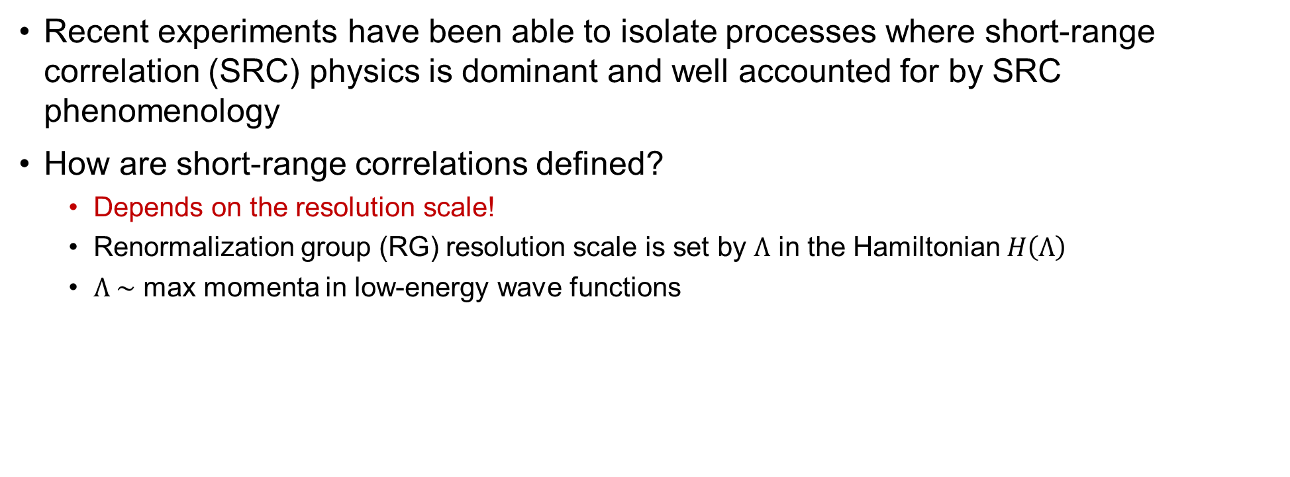
Short-range correlations
Recent experiments have been able to isolate processes where short-range correlation (SRC) physics is dominant and well accounted for by SRC phenomenology
How are short-range correlations defined?
Depends on the resolution scale!
Renormalization group (RG) resolution scale is set by $Λ$ in the Hamiltonian $H\left(Λ\right)$
$Λ \sim$ max momenta in low-energy wave functions

Slide 3
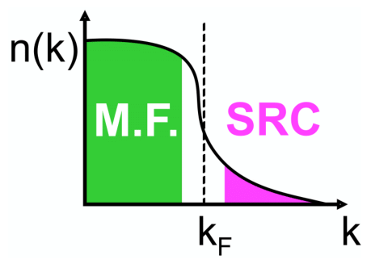
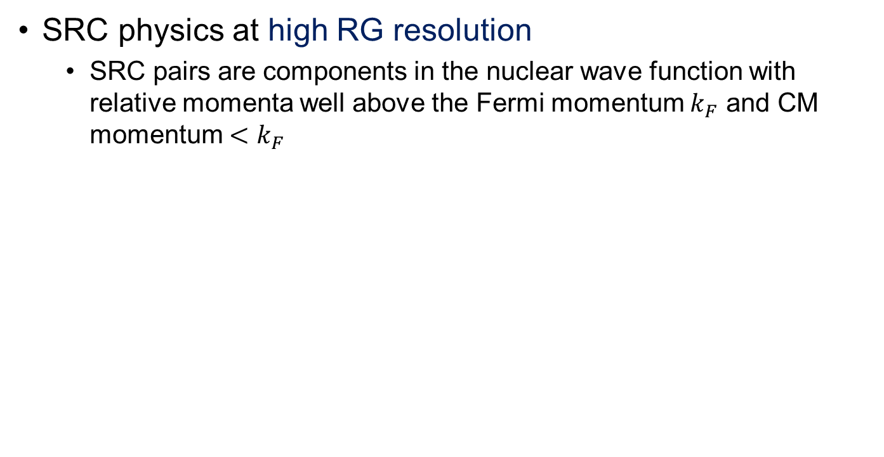
High and low RG resolution
SRC physics at high RG resolution
SRC pairs are components in the nuclear wave function with relative momenta well above the Fermi momentum $k_{F}$ and CM momentum $<k_{F}$
High RG resolution

Slide 4
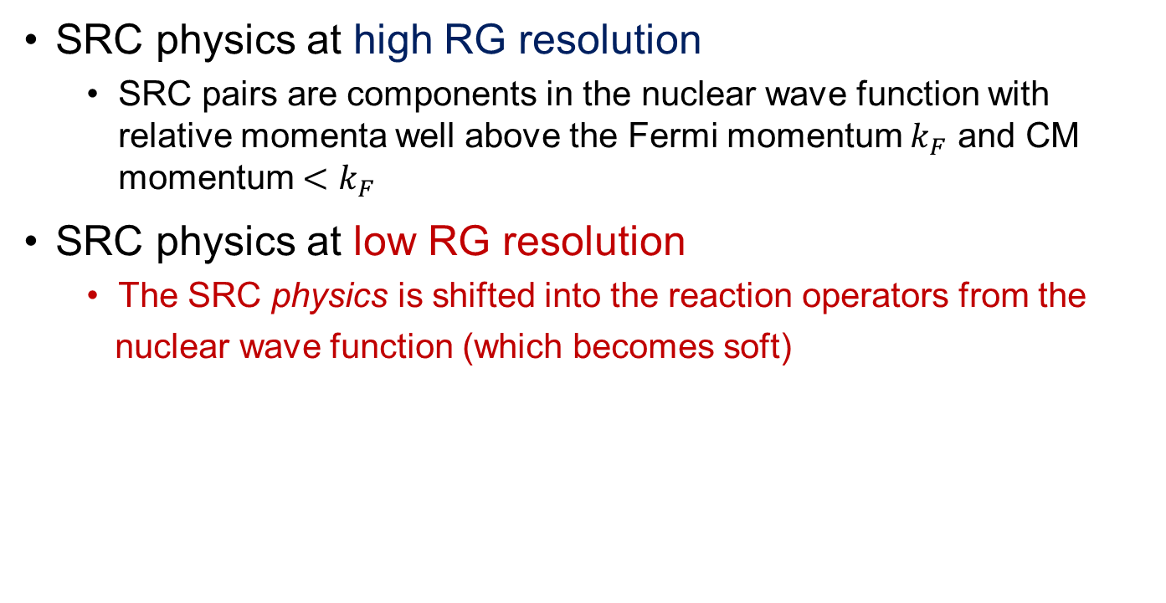
High and low RG resolution
SRC physics at high RG resolution
SRC pairs are components in the nuclear wave function with relative momenta well above the Fermi momentum $k_{F}$ and CM momentum $<k_{F}$
SRC physics at low RG resolution
The SRC physics is shifted into the reaction operators from the
nuclear wave function (which becomes soft)
Low RG resolution

Slide 5
High and low RG resolution
knock-out 2 high-k nucleons
High RG resolution: One-body current operators with correlated wave functions
excite SRC pair
same expt. resolution
low-k initial pair

Slide 6
High and low RG resolution
knock-out 2 high-k nucleons
High RG resolution: One-body current operators with correlated wave functions
Low RG resolution: Two-body current operators with uncorrelated wave functions
Operators do NOT become hard, which simplifies calculations!
excite SRC pair
same expt. resolution
low-k initial pair

Slide 7
High and low RG resolution
knock-out 2 high-k nucleons
High RG resolution: One-body current operators with correlated wave functions
Low RG resolution: Two-body current operators with uncorrelated wave functions
Operators do NOT become hard, which simplifies calculations!
Experimental resolution (set by momentum of probe) is the same in both pictures
Same observables but different physical interpretation!
excite SRC pair
same expt. resolution
low-k initial pair

Slide 8
High and low RG resolution
knock-out 2 high-k nucleons
High RG resolution: One-body current operators with correlated wave functions
Low RG resolution: Two-body current operators with uncorrelated wave functions
Operators do NOT become hard, which simplifies calculations!
Experimental resolution (set by momentum of probe) is the same in both pictures
Same observables but different physical interpretation!
This talk:
How can SRC calculations be carried out at low RG resolution?
What can we describe with simple approximations?
Connections to existing SRC phenomenology (e.g., GCF/LCA)
excite SRC pair
same expt. resolution
low-k initial pair

Slide 9
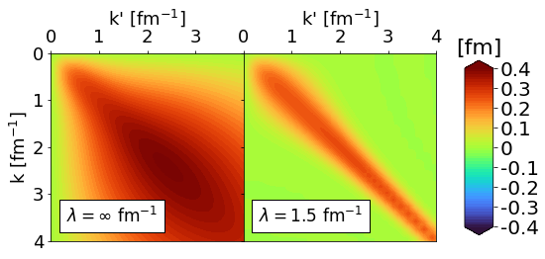
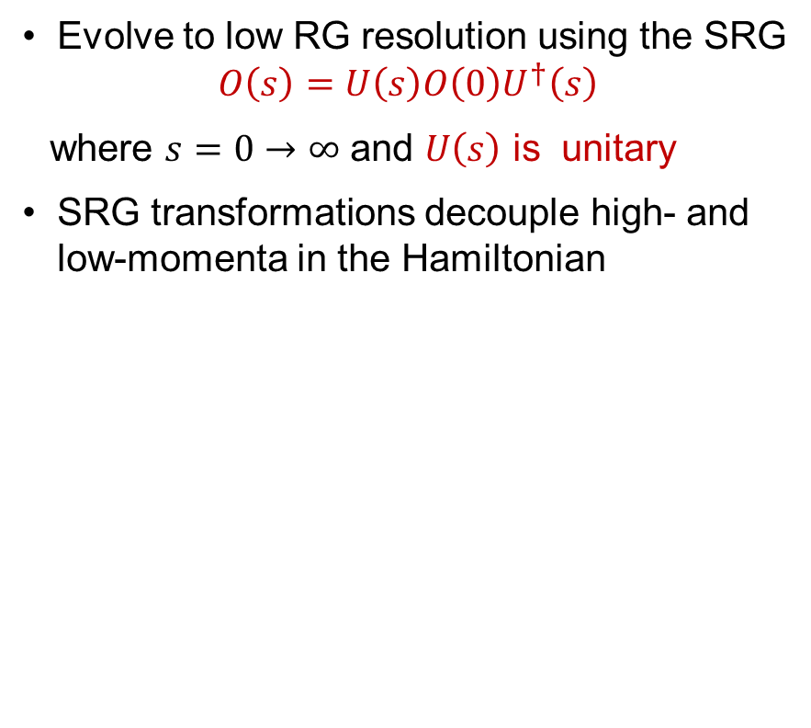
Similarity renormalization group
Evolve to low RG resolution using the SRG
$$O\left(s\right)=U\left(s\right)O\left(0\right)U^{†}\left(s\right)$$
where $s=0→∞$ and $U\left(s\right)$ is unitary
SRG transformations decouple high- and low-momenta in the Hamiltonian
Fig. 1: Momentum space matrix elements of Argonne v18 (AV18) under SRG evolution in ¹P₁ channel.

Slide 10
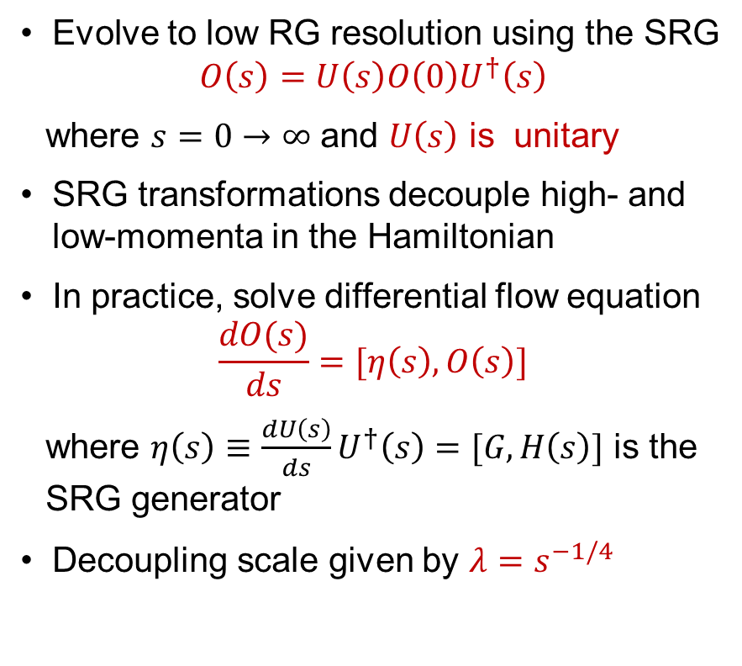
Similarity renormalization group
Evolve to low RG resolution using the SRG
$$O\left(s\right)=U\left(s\right)O\left(0\right)U^{†}\left(s\right)$$
where $s=0→∞$ and $U\left(s\right)$ is unitary
SRG transformations decouple high- and low-momenta in the Hamiltonian
In practice, solve differential flow equation
$$\frac{dO(s)}{ds}=[η\left(s\right),O\left(s\right)]$$
where $η\left(s\right)≡\frac{dU\left(s\right)}{ds}U^{†}\left(s\right)=[G,H\left(s\right)]$ is the SRG generator
Decoupling scale given by $λ=s^{−1/4}$
Fig. 1: Momentum space matrix elements of Argonne v18 (AV18) under SRG evolution in ¹P₁ channel.

Slide 11
Similarity renormalization group
SRC in AV18
AV18 wave function has significant SRC
What happens to the wave function under SRG transformation?
S-state
D-state
Fig. 2: SRG evolution of deuteron wave function in coordinate space for AV18 and Gezerlis N²LO¹.
¹A. Gezerlis et al., Phys. Rev. C 90, 054323 (2014)
Notes:
Consider deuteron wave function in coordinate space as an example, unevolved significant SRC, use SRG to go to low RG resolution.

Slide 12
Similarity renormalization group
SRC in AV18
No SRC
SRC physics in AV18 is gone from wave function at low RG resolution
Deuteron wave functions become soft and D-state probability goes down
Observables such as asymptotic D-S ratio are the same
SRG evolved
S-state
S-state
D-state
D-state
Fig. 2: SRG evolution of deuteron wave function in coordinate space for AV18 and Gezerlis N²LO¹.
¹A. Gezerlis et al., Phys. Rev. C 90, 054323 (2014)
Notes:
At low RG resolution, SRC physics in AV18 wave function is gone, both curves collapse on one another, D-state probability is suppressed, but observables are the same.

Slide 13
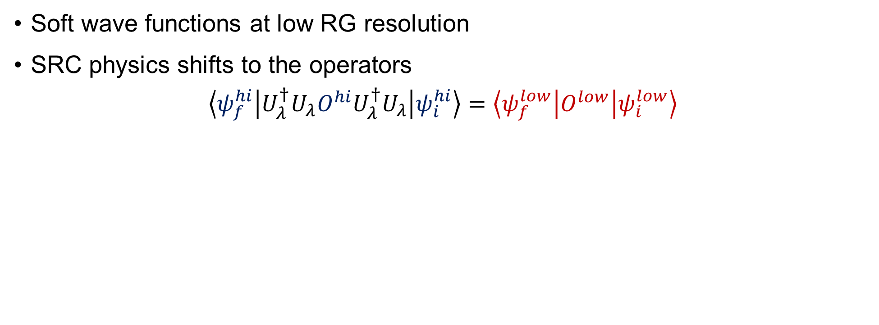
Operator evolution
Soft wave functions at low RG resolution
SRC physics shifts to the operators
$$\left\langle ψ_{f}^{hi} | U_{λ}^{†}U_{λ}O^{hi}U_{λ}^{†}U_{λ} | ψ_{i}^{hi}\right\rangle =\left\langle ψ_{f}^{low} | O^{low} | ψ_{i}^{low}\right\rangle$$

Slide 14
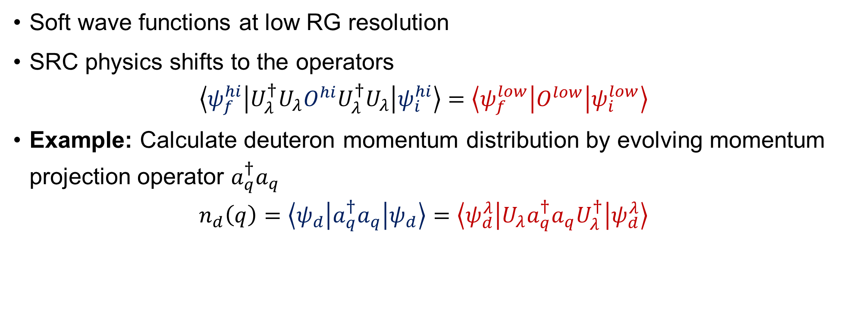
Operator evolution
Soft wave functions at low RG resolution
SRC physics shifts to the operators
$$\left\langle ψ_{f}^{hi} | U_{λ}^{†}U_{λ}O^{hi}U_{λ}^{†}U_{λ} | ψ_{i}^{hi}\right\rangle =\left\langle ψ_{f}^{low} | O^{low} | ψ_{i}^{low}\right\rangle$$
Example: Calculate deuteron momentum distribution by evolving momentum projection operator $a_{q}^{†}a_{q}$
$$n_{d}\left(q\right)=\left\langle ψ_{d} | a_{q}^{†}a_{q} | ψ_{d}\right\rangle =\left\langle ψ_{d}^{λ} | {U_{λ}a}_{q}^{†}a_{q}U_{λ}^{†} | ψ_{d}^{λ}\right\rangle$$

Slide 15
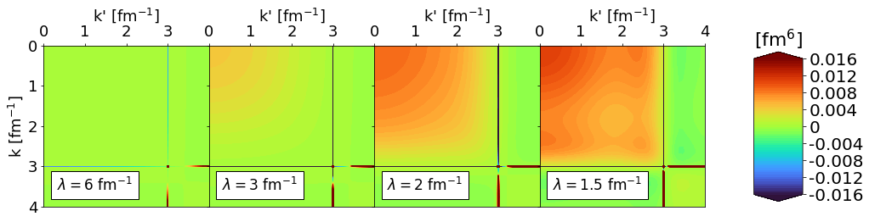
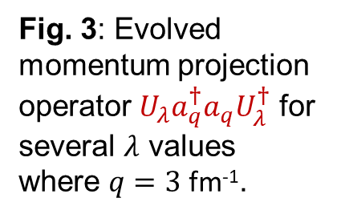
Operator evolution
Fig. 3: Evolved momentum projection operator ${U_{λ}a}_{q}^{†}a_{q}U_{λ}^{†}$ for several $λ$ values where $q=3$ fm⁻¹.
Notes:
Smooth induced contributions at low momentum reproduce UV physics of the original NN potential

Slide 16
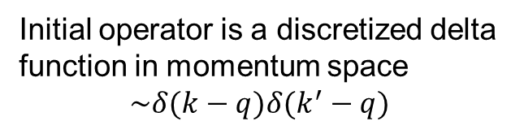
Operator evolution
Fig. 3: Evolved momentum projection operator ${U_{λ}a}_{q}^{†}a_{q}U_{λ}^{†}$ for several $λ$ values where $q=3$ fm⁻¹.
RG Scale
Initial operator is a discretized delta function in momentum space
$$\sim δ(k−q)δ(k^{′}−q)$$
SRG evolution induces smooth, low-momentum contributions
Notes:
Smooth induced contributions at low momentum reproduce UV physics of the original NN potential

Slide 17
Operator evolution
Fig. 3: Evolved momentum projection operator ${U_{λ}a}_{q}^{†}a_{q}U_{λ}^{†}$ for several $λ$ values where $q=3$ fm⁻¹.
SRG evolution of hard potential does NOT make the reaction operator hard!
RG Scale
Initial operator is a discretized delta function in momentum space
$$\sim δ(k−q)δ(k^{′}−q)$$
SRG evolution induces smooth, low-momentum contributions
Notes:
Smooth induced contributions at low momentum reproduce UV physics of the original NN potential

Slide 18
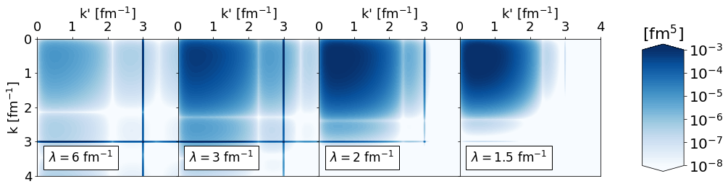
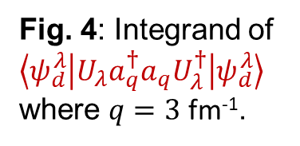
Operator evolution
Fig. 3: Evolved momentum projection operator ${U_{λ}a}_{q}^{†}a_{q}U_{λ}^{†}$ for several $λ$ values where $q=3$ fm⁻¹.
Fig. 4: Integrand of $\left\langle ψ_{d}^{λ} | {U_{λ}a}_{q}^{†}a_{q}U_{λ}^{†} | ψ_{d}^{λ}\right\rangle$where $q=3$ fm⁻¹.
Notes:
Smooth induced contributions at low momentum reproduce UV physics of the original NN potential

Slide 19
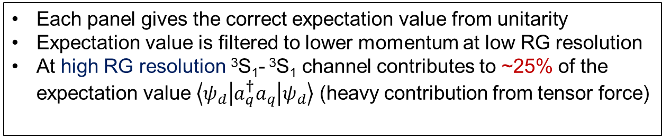
Operator evolution
Fig. 3: Evolved momentum projection operator ${U_{λ}a}_{q}^{†}a_{q}U_{λ}^{†}$ for several $λ$ values where $q=3$ fm⁻¹.
Each panel gives the correct expectation value from unitarity
Expectation value is filtered to lower momentum at low RG resolution
At high RG resolution ³S₁- ³S₁ channel contributes to ~25% of the expectation value $\left\langle ψ_{d} | a_{q}^{†}a_{q} | ψ_{d}\right\rangle$ (heavy contribution from tensor force)
Fig. 4: Integrand of $\left\langle ψ_{d}^{λ} | {U_{λ}a}_{q}^{†}a_{q}U_{λ}^{†} | ψ_{d}^{λ}\right\rangle$where $q=3$ fm⁻¹.
Notes:
Smooth induced contributions at low momentum reproduce UV physics of the original NN potential

Slide 20
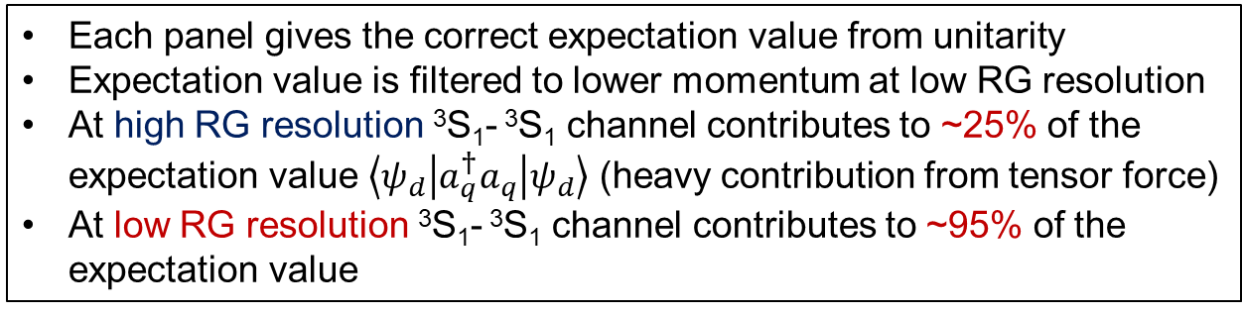
Operator evolution
Fig. 3: Evolved momentum projection operator ${U_{λ}a}_{q}^{†}a_{q}U_{λ}^{†}$ for several $λ$ values where $q=3$ fm⁻¹.
Each panel gives the correct expectation value from unitarity
Expectation value is filtered to lower momentum at low RG resolution
At high RG resolution ³S₁- ³S₁ channel contributes to ~25% of the expectation value $\left\langle ψ_{d} | a_{q}^{†}a_{q} | ψ_{d}\right\rangle$ (heavy contribution from tensor force)
At low RG resolution ³S₁- ³S₁ channel contributes to ~95% of the expectation value
Fig. 4: Integrand of $\left\langle ψ_{d}^{λ} | {U_{λ}a}_{q}^{†}a_{q}U_{λ}^{†} | ψ_{d}^{λ}\right\rangle$where $q=3$ fm⁻¹.
Notes:
Smooth induced contributions at low momentum reproduce UV physics of the original NN potential

Slide 21
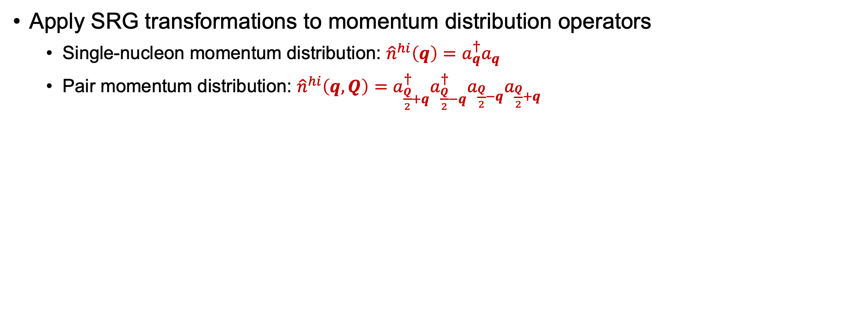
Momentum distributions at low RG resolution
Apply SRG transformations to momentum distribution operators
Single-nucleon momentum distribution: ${\hat{n}}^{hi}\left(q\right)=a_{q}^{†}a_{q}$
Pair momentum distribution: ${\hat{n}}^{hi}\left(q,Q\right)=a_{\frac{Q}{2}+q}^{†}{a_{\frac{Q}{2}−q}^{†}a}_{\frac{Q}{2}−q}a_{\frac{Q}{2}+q}$

Slide 22
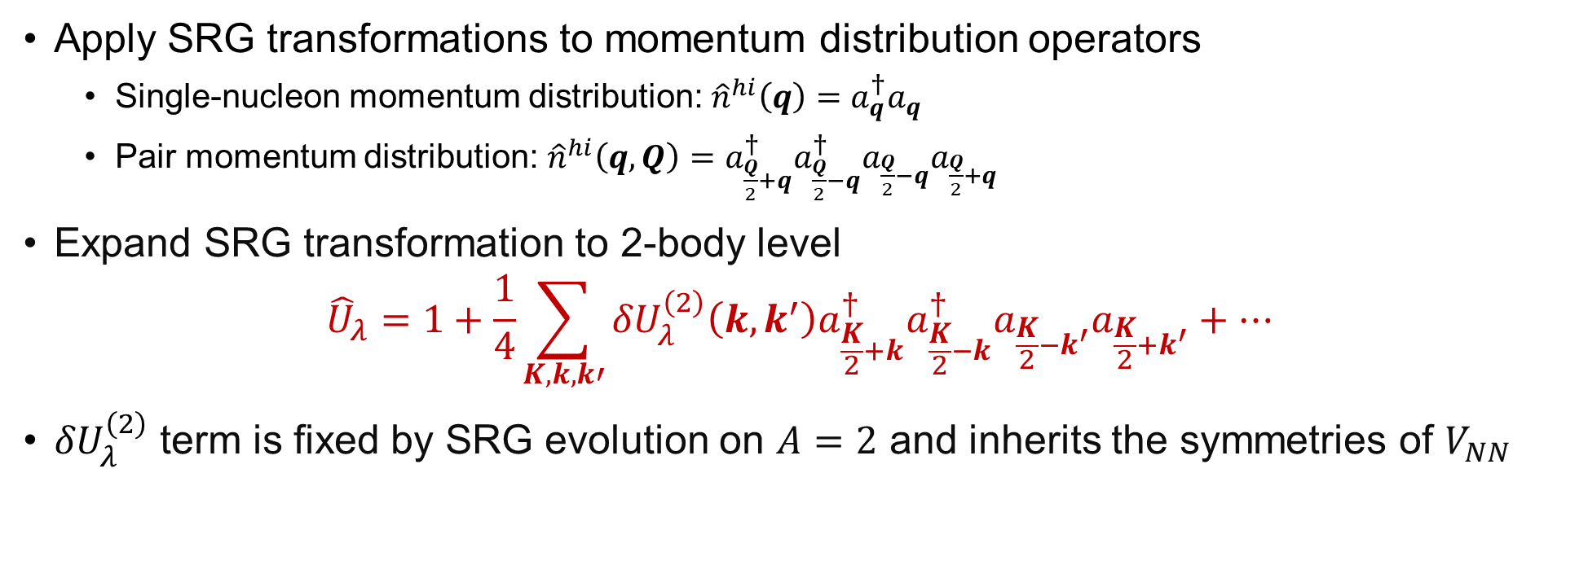
Momentum distributions at low RG resolution
Apply SRG transformations to momentum distribution operators
Single-nucleon momentum distribution: ${\hat{n}}^{hi}\left(q\right)=a_{q}^{†}a_{q}$
Pair momentum distribution: ${\hat{n}}^{hi}\left(q,Q\right)=a_{\frac{Q}{2}+q}^{†}{a_{\frac{Q}{2}−q}^{†}a}_{\frac{Q}{2}−q}a_{\frac{Q}{2}+q}$
Expand SRG transformation to 2-body level
$${\hat{U}}_{λ}=1+\frac{1}{4}\sum_{K,k,k′}{{δU}_{λ}^{\left(2\right)}\left(k,k^{′}\right)a_{\frac{K}{2}+k}^{†}a_{\frac{K}{2}−k}^{†}a_{\frac{K}{2}−k^{′}}a_{\frac{K}{2}+k^{′}}+⋯}$$
${δU}_{λ}^{\left(2\right)}$ term is fixed by SRG evolution on $A=2$ and inherits the symmetries of $V_{NN}$
Notes:
\delta U has Galilean invariance and transforms to partial waves same as V_NN.

Slide 23
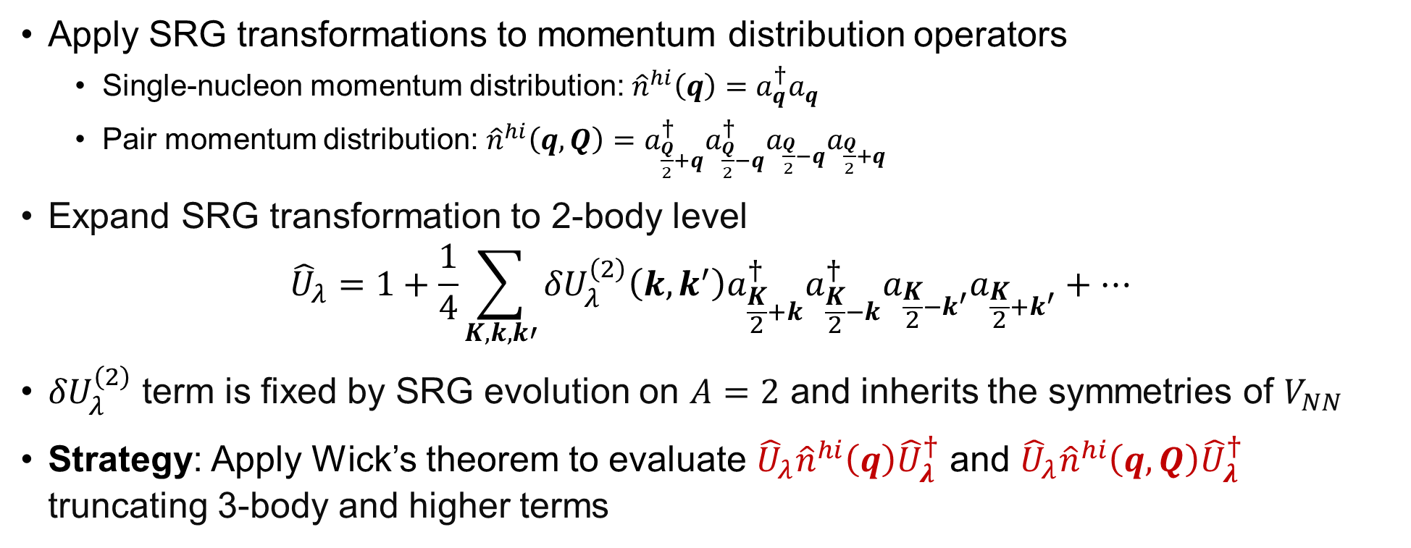
Momentum distributions at low RG resolution
Apply SRG transformations to momentum distribution operators
Single-nucleon momentum distribution: ${\hat{n}}^{hi}\left(q\right)=a_{q}^{†}a_{q}$
Pair momentum distribution: ${\hat{n}}^{hi}\left(q,Q\right)=a_{\frac{Q}{2}+q}^{†}{a_{\frac{Q}{2}−q}^{†}a}_{\frac{Q}{2}−q}a_{\frac{Q}{2}+q}$
Expand SRG transformation to 2-body level
$${\hat{U}}_{λ}=1+\frac{1}{4}\sum_{K,k,k′}{{δU}_{λ}^{\left(2\right)}\left(k,k^{′}\right)a_{\frac{K}{2}+k}^{†}a_{\frac{K}{2}−k}^{†}a_{\frac{K}{2}−k^{′}}a_{\frac{K}{2}+k^{′}}+⋯}$$
${δU}_{λ}^{\left(2\right)}$ term is fixed by SRG evolution on $A=2$ and inherits the symmetries of $V_{NN}$
Strategy: Apply Wick’s theorem to evaluate ${\hat{U}}_{λ}{\hat{n}}^{hi}\left(q\right){\hat{U}}_{λ}^{†}$ and ${\hat{U}}_{λ}{\hat{n}}^{hi}\left(q,Q\right){\hat{U}}_{λ}^{†}$ truncating 3-body and higher terms

Slide 24
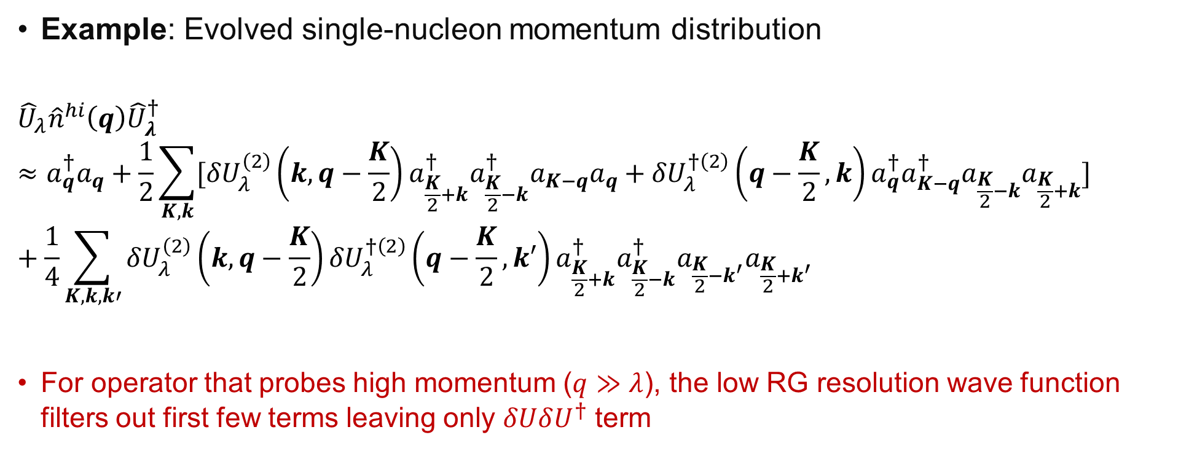
Momentum distributions at low RG resolution
Example: Evolved single-nucleon momentum distribution
$${\hat{U}}_{λ}{\hat{n}}^{hi}\left(q\right){\hat{U}}_{λ}^{†}≈a_{q}^{†}a_{q}+\frac{1}{2}\sum_{K,k}{[{δU}_{λ}^{\left(2\right)}\left(k,q−\frac{K}{2}\right)a_{\frac{K}{2}+k}^{†}a_{\frac{K}{2}−k}^{†}a_{K−q}a_{q}+{δU}_{λ}^{†\left(2\right)}\left(q−\frac{K}{2},k\right)a_{q}^{†}a_{K−q}^{†}a_{\frac{K}{2}−k}a_{\frac{K}{2}+k}}]+\frac{1}{4}\sum_{K,k,k′}{{δU}_{λ}^{\left(2\right)}\left(k,q−\frac{K}{2}\right)}{δU}_{λ}^{†\left(2\right)}\left(q−\frac{K}{2},k′\right)a_{\frac{K}{2}+k}^{†}a_{\frac{K}{2}−k}^{†}a_{\frac{K}{2}−k^{′}}a_{\frac{K}{2}+k^{′}}$$
For operator that probes high momentum ($q≫λ$), the low RG resolution wave function filters out first few terms leaving only $δUδU^{†}$ term

Slide 25
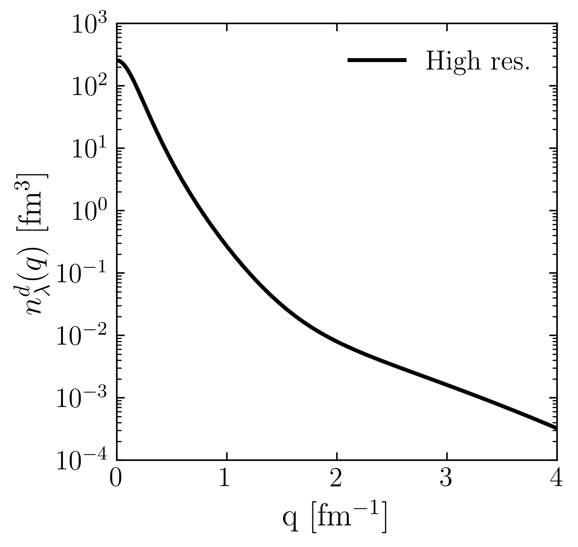
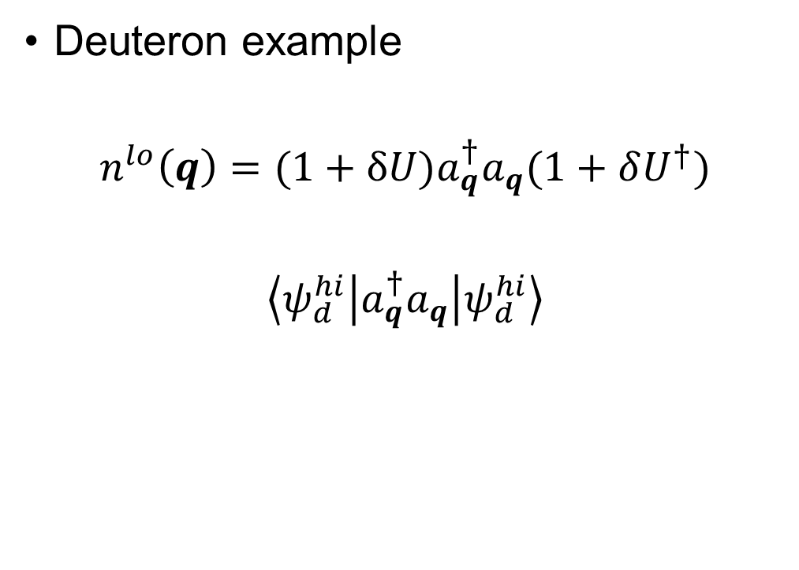
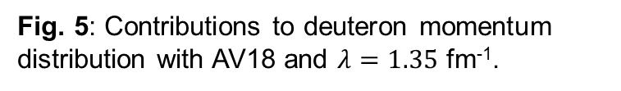
Momentum distributions at low RG resolution
Deuteron example
$$n^{lo}\left(q\right)=(1+δU)a_{q}^{†}a_{q}(1+δU^{†})$$
$$\left\langle ψ_{d}^{hi} | a_{q}^{†}a_{q} | ψ_{d}^{hi}\right\rangle$$
Fig. 5: Contributions to deuteron momentum distribution with AV18 and $λ=1.35$ fm⁻¹.
Notes:
Use deuteron in momentum space as an example and consider contributions to the full distribution in terms of 1 and \delta U. Here is the full result.

Slide 26
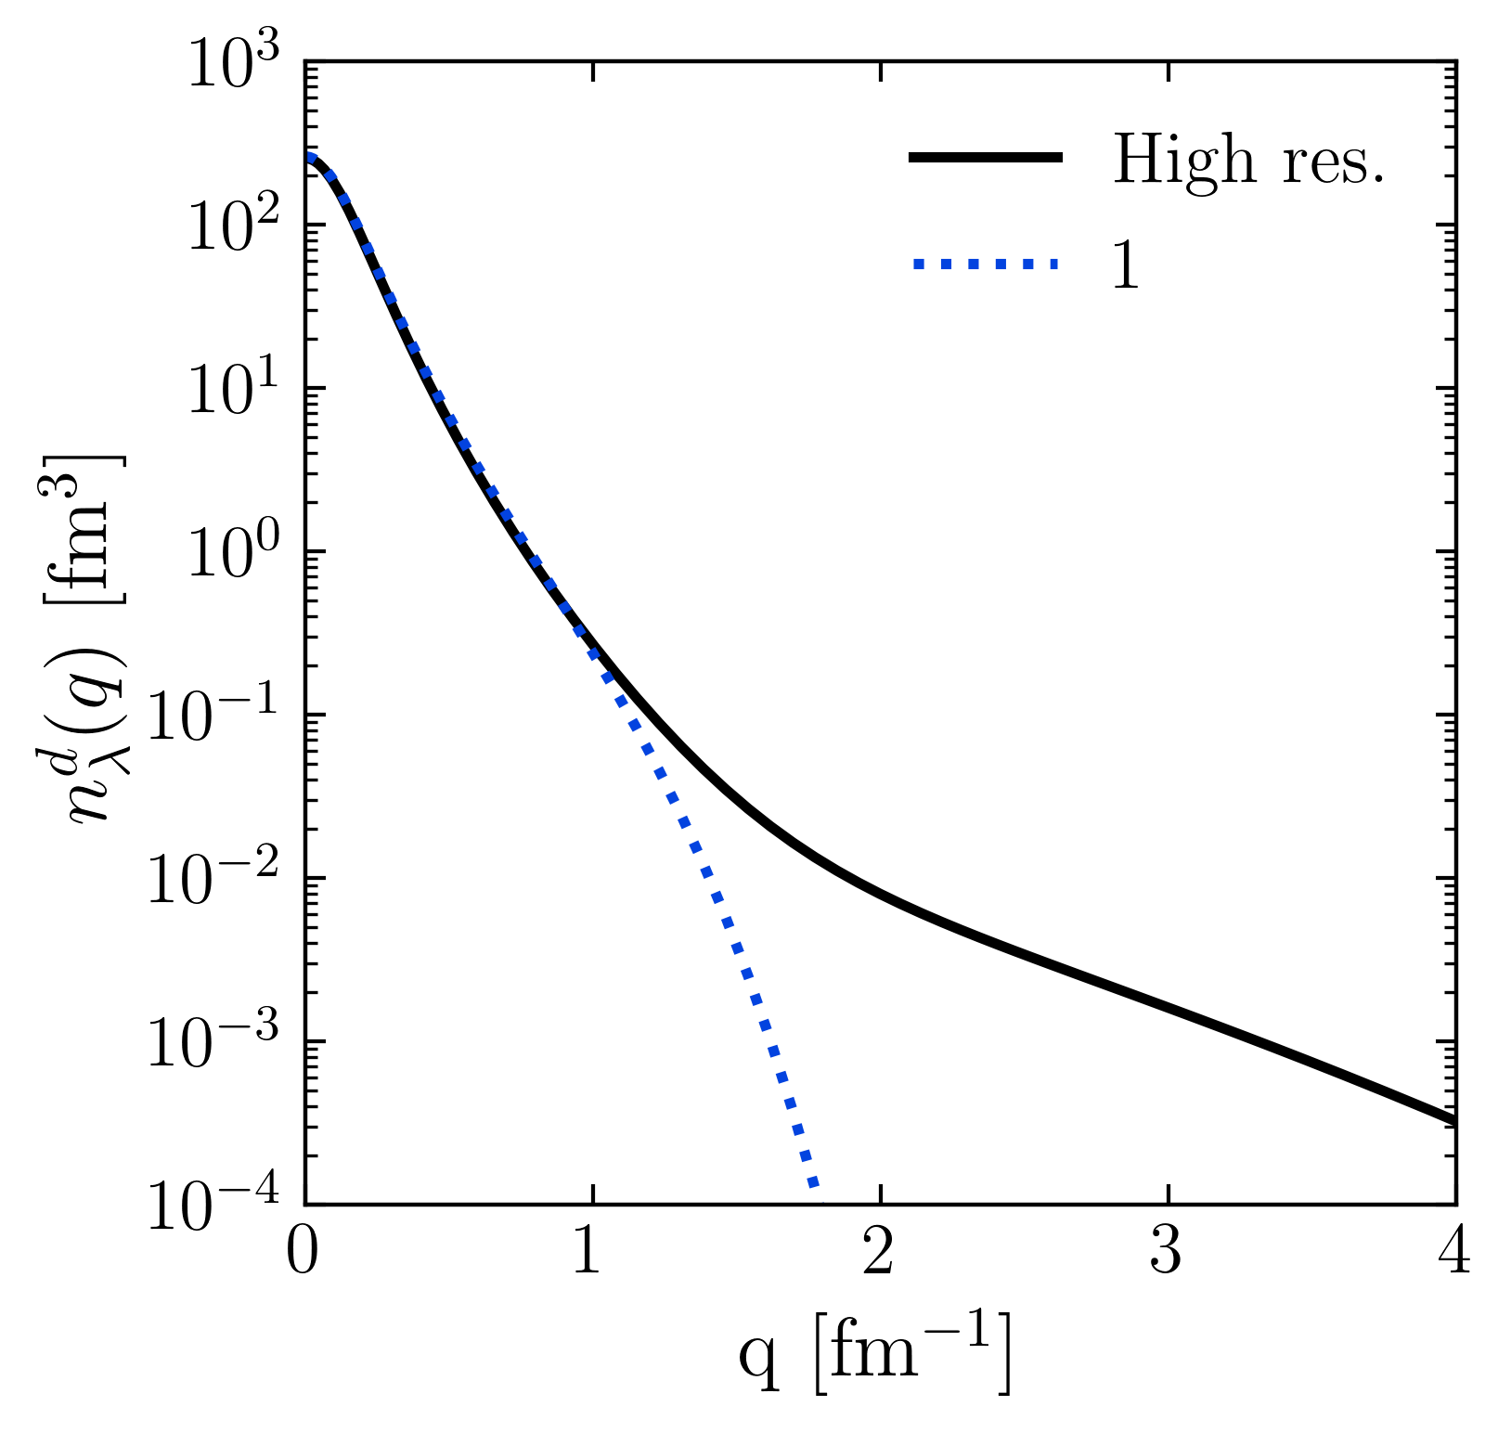
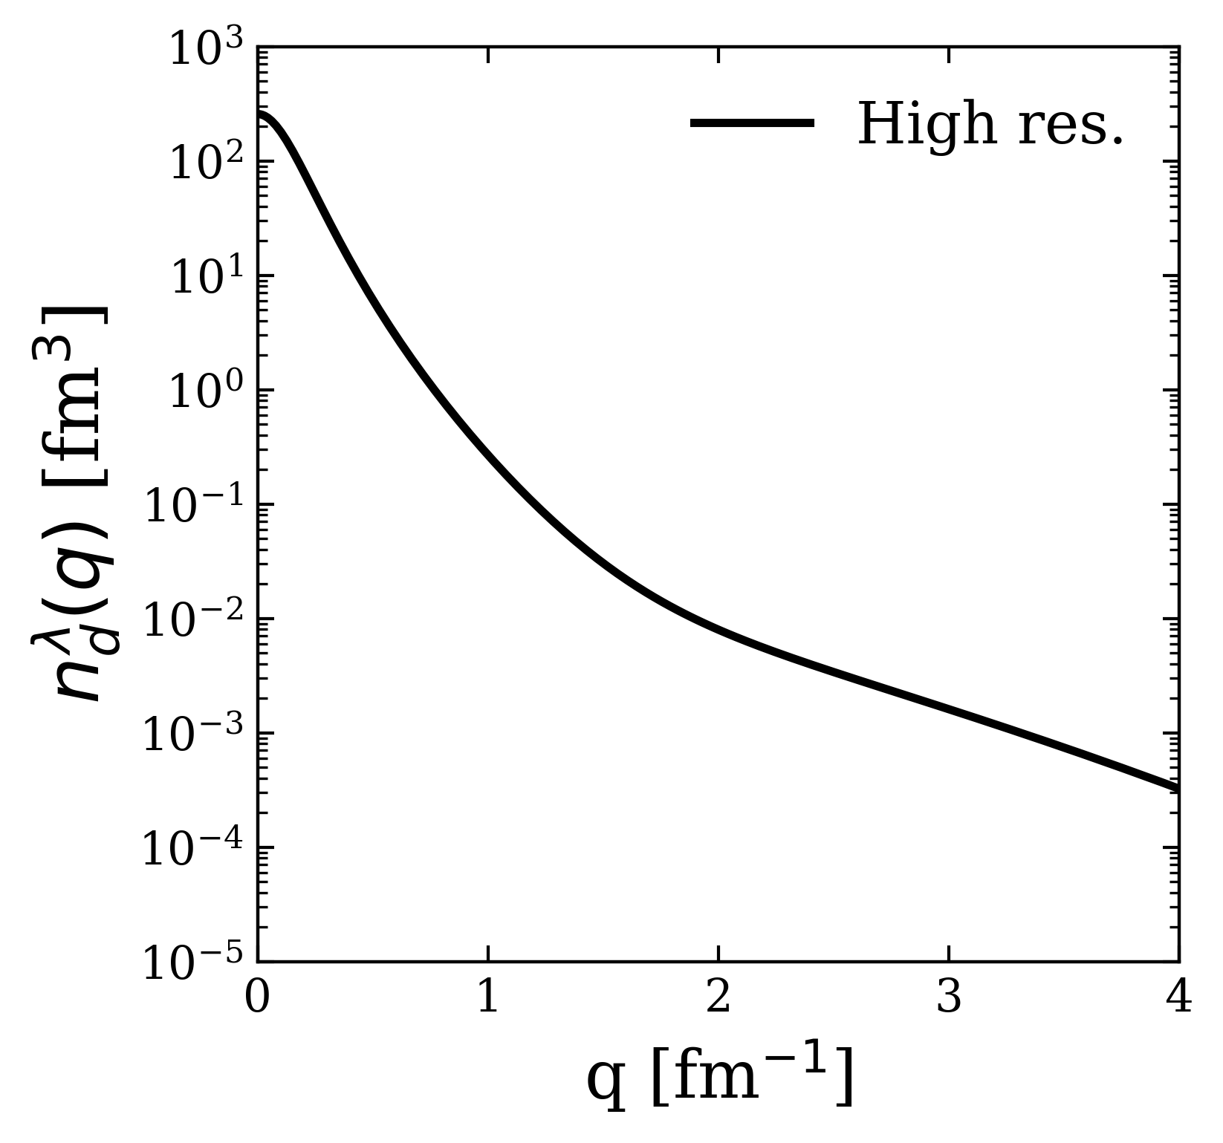
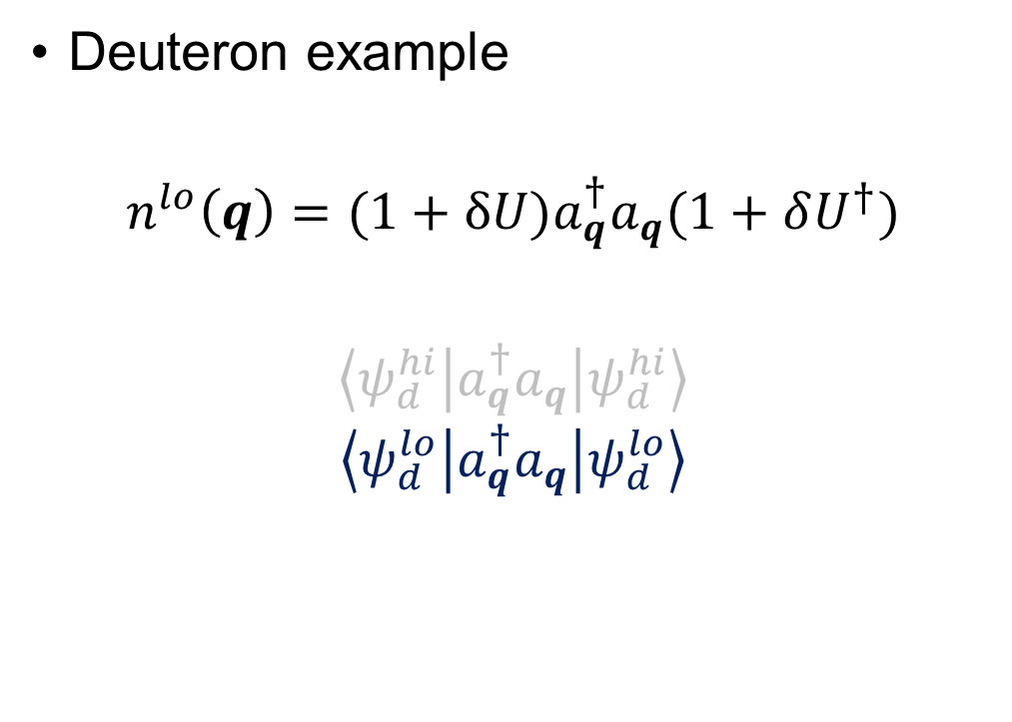
Momentum distributions at low RG resolution
Deuteron example
$$n^{lo}\left(q\right)=(1+δU)a_{q}^{†}a_{q}(1+δU^{†})$$
$$\left\langle ψ_{d}^{hi} | a_{q}^{†}a_{q} | ψ_{d}^{hi}\right\rangle$$
$$\left\langle ψ_{d}^{lo} | a_{q}^{†}a_{q} | ψ_{d}^{lo}\right\rangle$$
Fig. 5: Contributions to deuteron momentum distribution with AV18 and $λ=1.35$ fm⁻¹.
Notes:
Taking only 1.

Slide 27
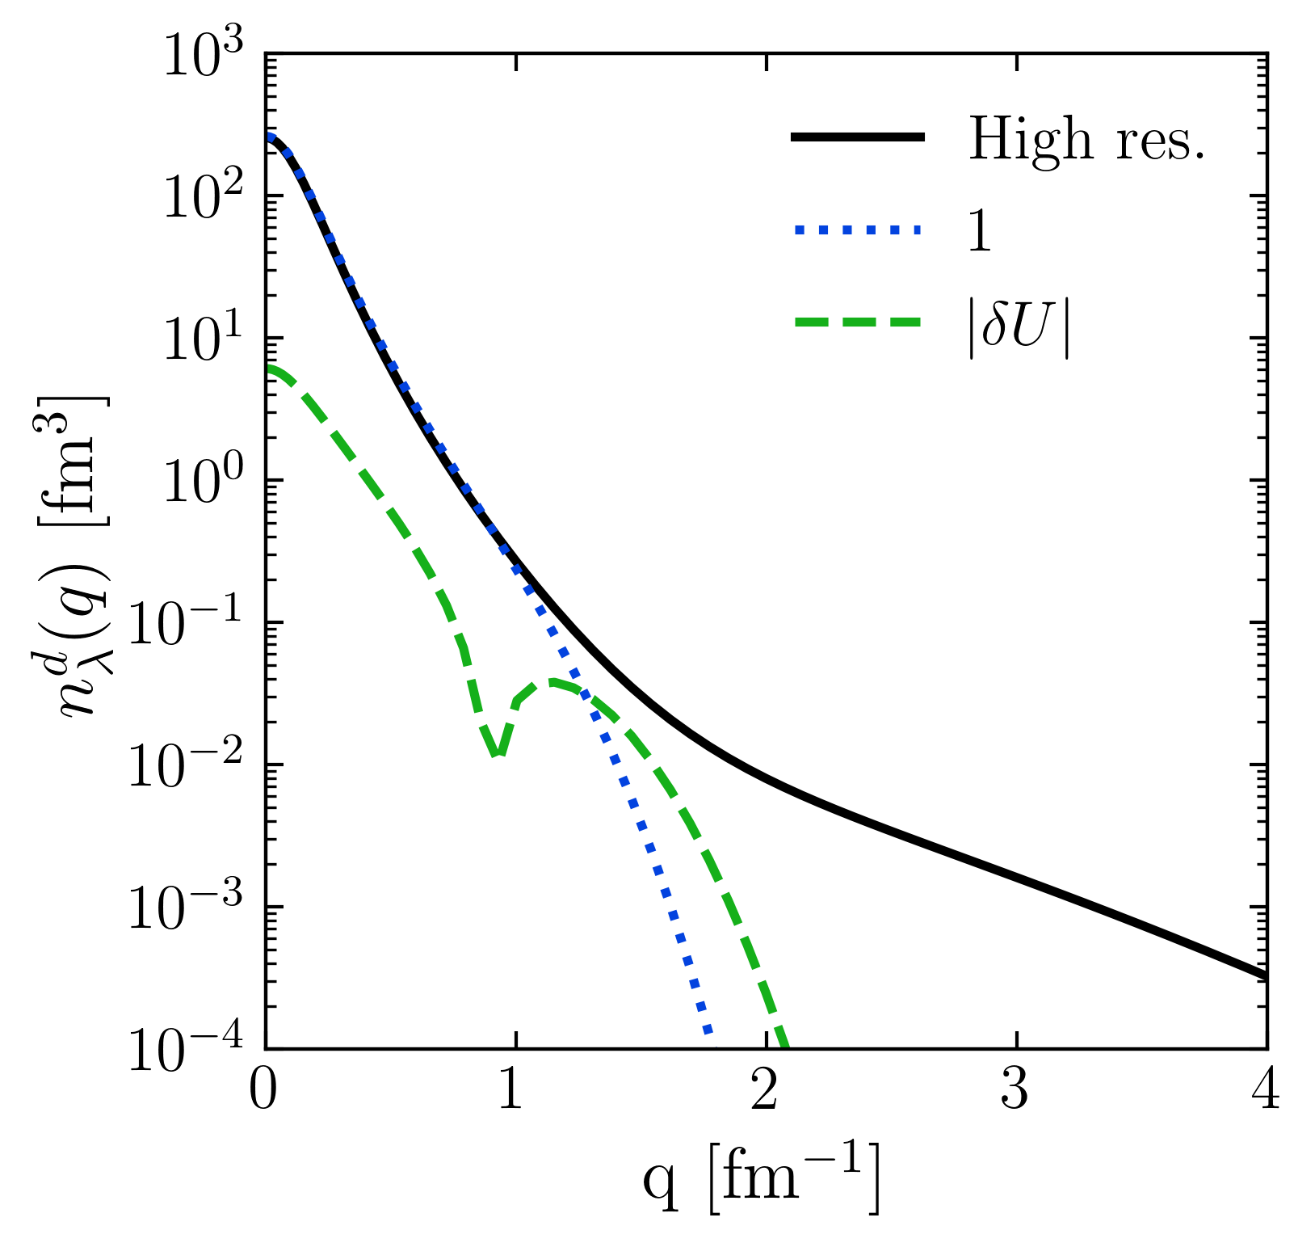
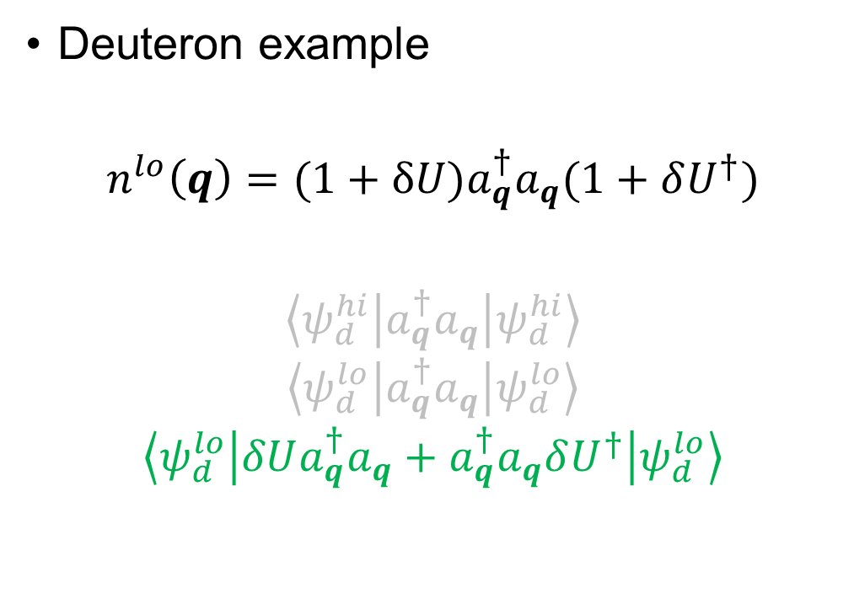
Momentum distributions at low RG resolution
Deuteron example
$$n^{lo}\left(q\right)=(1+δU)a_{q}^{†}a_{q}(1+δU^{†})$$
$$\left\langle ψ_{d}^{hi} | a_{q}^{†}a_{q} | ψ_{d}^{hi}\right\rangle$$
$$\left\langle ψ_{d}^{lo} | a_{q}^{†}a_{q} | ψ_{d}^{lo}\right\rangle$$
$$\left\langle ψ_{d}^{lo} | δUa_{q}^{†}a_{q}+a_{q}^{†}a_{q}δU^{†} | ψ_{d}^{lo}\right\rangle$$
Fig. 5: Contributions to deuteron momentum distribution with AV18 and $λ=1.35$ fm⁻¹.
Notes:
Taking only \delta U.

Slide 28
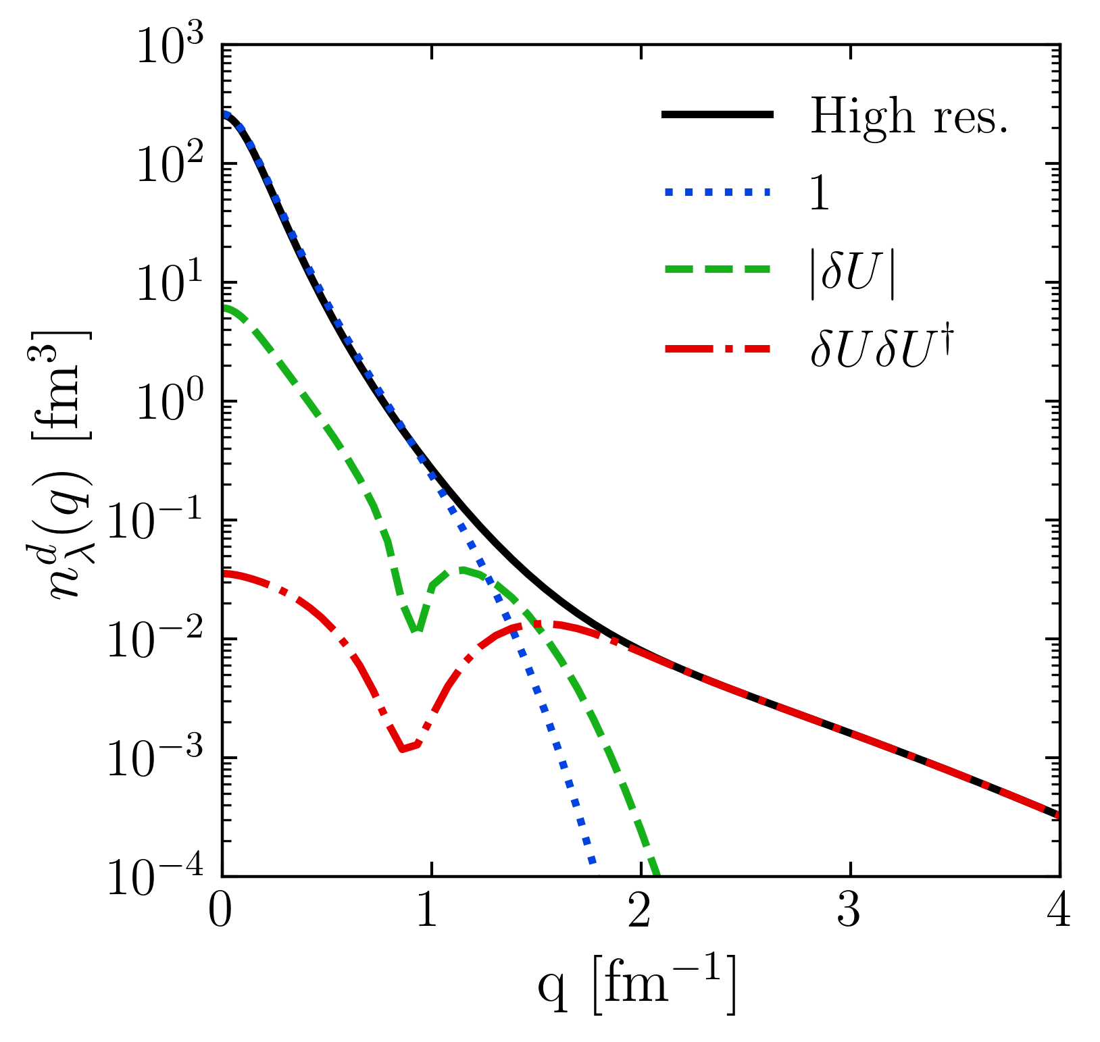
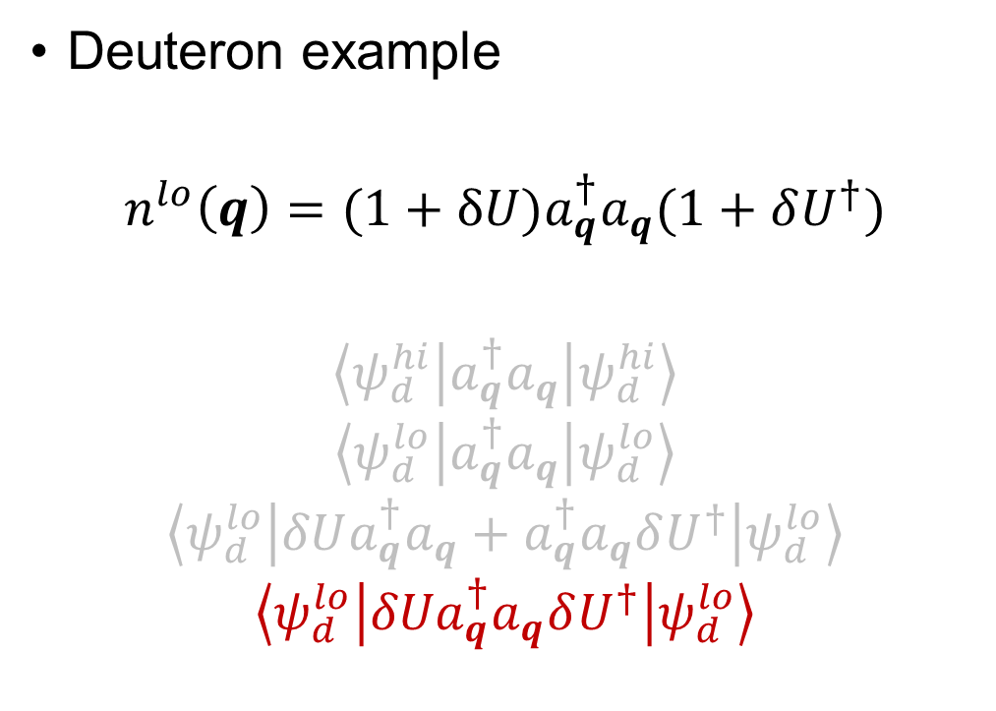
Momentum distributions at low RG resolution
Deuteron example
$$n^{lo}\left(q\right)=(1+δU)a_{q}^{†}a_{q}(1+δU^{†})$$
$$\left\langle ψ_{d}^{hi} | a_{q}^{†}a_{q} | ψ_{d}^{hi}\right\rangle$$
$$\left\langle ψ_{d}^{lo} | a_{q}^{†}a_{q} | ψ_{d}^{lo}\right\rangle$$
$$\left\langle ψ_{d}^{lo} | δUa_{q}^{†}a_{q}+a_{q}^{†}a_{q}δU^{†} | ψ_{d}^{lo}\right\rangle$$
$$\left\langle ψ_{d}^{lo} | {δUa}_{q}^{†}a_{q}δU^{†} | ψ_{d}^{lo}\right\rangle$$
Fig. 5: Contributions to deuteron momentum distribution with AV18 and $λ=1.35$ fm⁻¹.
Notes:
Taking \delta U \delta U^\dagger -> gives high-momentum tail.

Slide 29
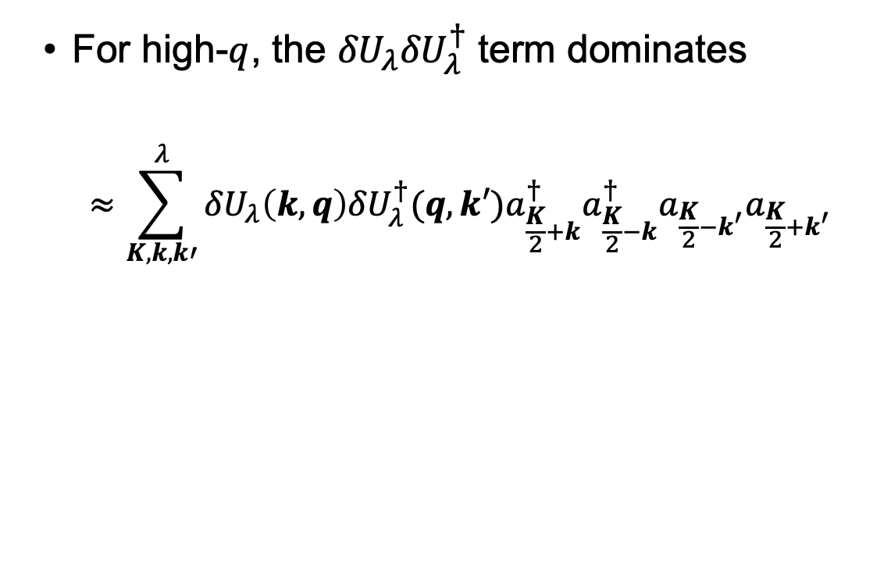
Momentum distributions at low RG resolution
For high-$q$, the ${δU}_{λ}{δU}_{λ}^{†}$ term dominates
$$≈\sum_{K,k,k′}^{λ}{{δU}_{λ}\left(k,q\right){{δU}_{λ}^{†}(q,k′)a}_{\frac{K}{2}+k}^{†}a_{\frac{K}{2}−k}^{†}a_{\frac{K}{2}−k^{′}}a_{\frac{K}{2}+k^{′}}}$$
Fig. 5: Contributions to deuteron momentum distribution with AV18 and $λ=1.35$ fm⁻¹.
Notes:
Read bullet.

Slide 30
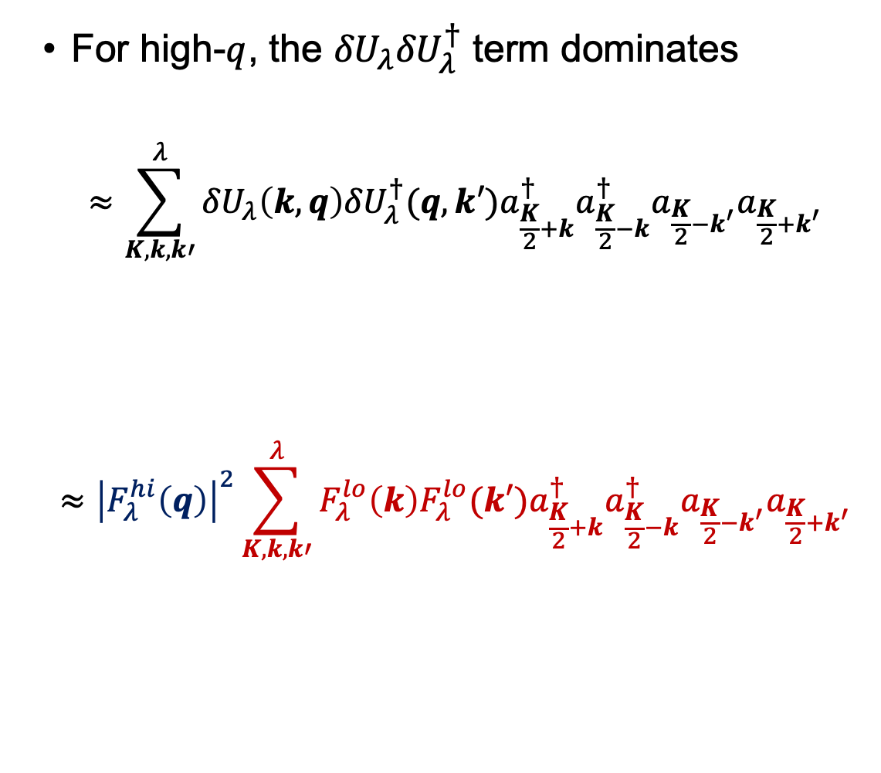
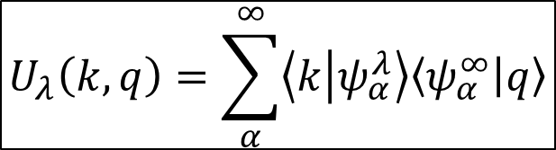
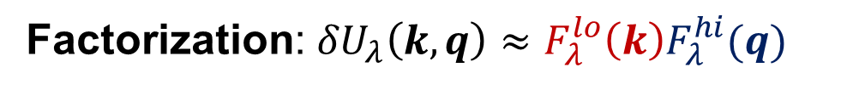
Momentum distributions at low RG resolution
For high-$q$, the ${δU}_{λ}{δU}_{λ}^{†}$ term dominates
$$≈\sum_{K,k,k′}^{λ}{{δU}_{λ}\left(k,q\right){{δU}_{λ}^{†}(q,k′)a}_{\frac{K}{2}+k}^{†}a_{\frac{K}{2}−k}^{†}a_{\frac{K}{2}−k^{′}}a_{\frac{K}{2}+k^{′}}}$$
$$≈{\left|F_{λ}^{hi}\left(q\right)\right|}^{2}\sum_{K,k,k′}^{λ}{F_{λ}^{lo}\left(k\right){F_{λ}^{lo}(k′)a}_{\frac{K}{2}+k}^{†}a_{\frac{K}{2}−k}^{†}a_{\frac{K}{2}−k^{′}}a_{\frac{K}{2}+k^{′}}}$$
$$U_{λ}\left(k,q\right)=\sum_{α}^{∞}{\left\langle k | ψ_{α}^{λ}\right\rangle \left\langle ψ_{α}^{∞} | q\right\rangle }$$
Factorization: ${δU}_{λ}\left(k,q\right)≈F_{λ}^{lo}{\left(k\right)F}_{λ}^{hi}(q)$
Fig. 5: Contributions to deuteron momentum distribution with AV18 and $λ=1.35$ fm⁻¹.
Notes:
Furthermore, using the spectral represe factorizes so we are left with the high-momentum dependence out in front here (point) and the rest is at low momentum (well reproduced by MF).
Factorization from OPE.

Slide 31
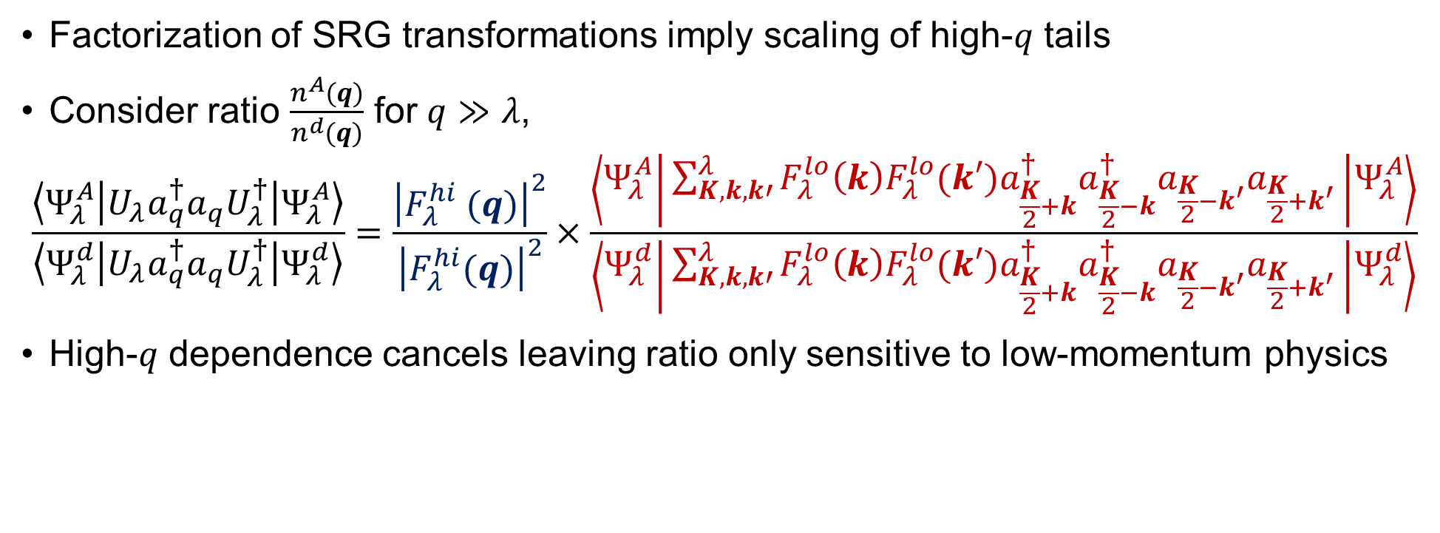
Factorization
Factorization of SRG transformations imply scaling of high-$q$ tails
Consider ratio $\frac{n^{A}(q)}{n^{d}(q)}$ for $q≫λ$,
$$\frac{\left\langle Ψ_{λ}^{A} | {U_{λ}a}_{q}^{†}a_{q}U_{λ}^{†} | Ψ_{λ}^{A}\right\rangle }{\left\langle Ψ_{λ}^{d} | {U_{λ}a}_{q}^{†}a_{q}U_{λ}^{†} | Ψ_{λ}^{d}\right\rangle }=\frac{{\left|F_{λ}^{hi} (q)\right|}^{2}}{{\left|F_{λ}^{hi}(q)\right|}^{2}}×\frac{\left\langle Ψ_{λ}^{A} | \sum_{K,k,k′}^{λ}{F_{λ}^{lo}\left(k\right){F_{λ}^{lo}(k′)a}_{\frac{K}{2}+k}^{†}a_{\frac{K}{2}−k}^{†}a_{\frac{K}{2}−k^{′}}a_{\frac{K}{2}+k^{′}}} | Ψ_{λ}^{A}\right\rangle }{\left\langle Ψ_{λ}^{d} | \sum_{K,k,k′}^{λ}{F_{λ}^{lo}\left(k\right){F_{λ}^{lo}(k′)a}_{\frac{K}{2}+k}^{†}a_{\frac{K}{2}−k}^{†}a_{\frac{K}{2}−k^{′}}a_{\frac{K}{2}+k^{′}}} | Ψ_{λ}^{d}\right\rangle }$$
High-$q$ dependence cancels leaving ratio only sensitive to low-momentum physics

Slide 32
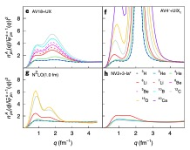
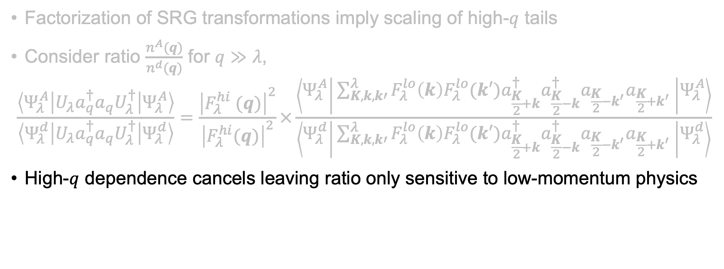
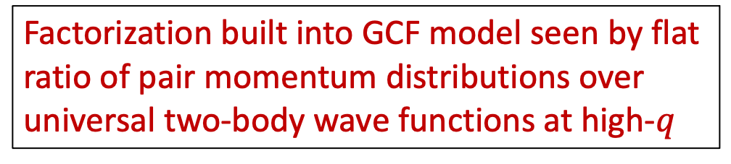
Factorization
Figure from R. Cruz-Torres et al., Nat. Phys. 17, 306 (2021)
Factorization of SRG transformations imply scaling of high-$q$ tails
Consider ratio $\frac{n^{A}(q)}{n^{d}(q)}$ for $q≫λ$,
$$\frac{\left\langle Ψ_{λ}^{A} | {U_{λ}a}_{q}^{†}a_{q}U_{λ}^{†} | Ψ_{λ}^{A}\right\rangle }{\left\langle Ψ_{λ}^{d} | {U_{λ}a}_{q}^{†}a_{q}U_{λ}^{†} | Ψ_{λ}^{d}\right\rangle }=\frac{{\left|F_{λ}^{hi} (q)\right|}^{2}}{{\left|F_{λ}^{hi}(q)\right|}^{2}}×\frac{\left\langle Ψ_{λ}^{A} | \sum_{K,k,k′}^{λ}{F_{λ}^{lo}\left(k\right){F_{λ}^{lo}(k′)a}_{\frac{K}{2}+k}^{†}a_{\frac{K}{2}−k}^{†}a_{\frac{K}{2}−k^{′}}a_{\frac{K}{2}+k^{′}}} | Ψ_{λ}^{A}\right\rangle }{\left\langle Ψ_{λ}^{d} | \sum_{K,k,k′}^{λ}{F_{λ}^{lo}\left(k\right){F_{λ}^{lo}(k′)a}_{\frac{K}{2}+k}^{†}a_{\frac{K}{2}−k}^{†}a_{\frac{K}{2}−k^{′}}a_{\frac{K}{2}+k^{′}}} | Ψ_{λ}^{d}\right\rangle }$$
High-$q$ dependence cancels leaving ratio only sensitive to low-momentum physics
Factorization built into GCF model seen by flat ratio of pair momentum distributions over universal two-body wave functions at high-$q$
Notes:
As an example of how this works in other phenomenologies, the GCF assumes a factorized form of the momentum distribution which is seen in this plot on the left where…

Slide 33
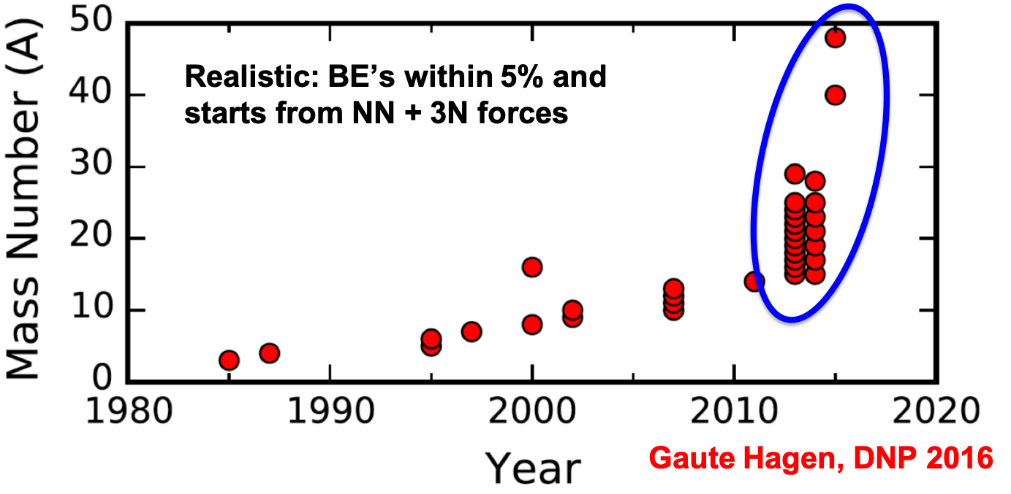
Why low RG resolution?
Methods that rely on soft interactions work well!
Notes:
Many-body methods that utilize soft interactions have seen much progress recently.
Describe nuclear hockey stick figure.

Slide 34
Why low RG resolution?
Methods that rely on soft interactions work well!
What SRC physics can we describe using simple approximations?
Try Hartree-Fock (HF) with a local density approximation (LDA) to evaluate nuclear matrix elements
Notes:
So we want to try describing SRC physics using very simple approximations to approximate the nuclear structure component of our calculations.
Start with HF with an LDA to evaluate nuclear matrix elements.

Slide 35
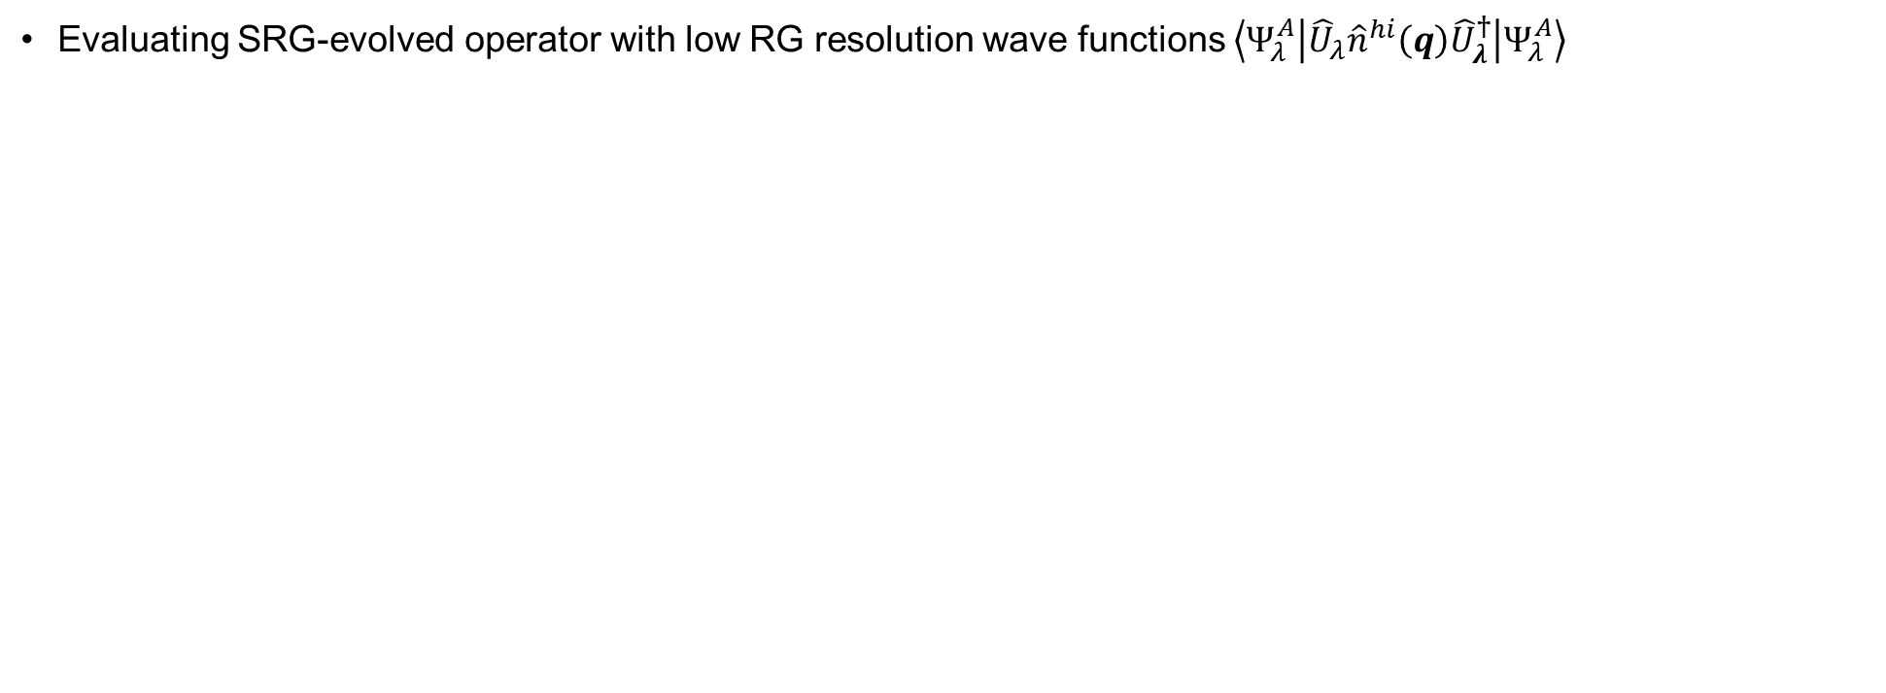
HF and LDA calculation
Evaluating SRG-evolved operator with low RG resolution wave functions $\left\langle Ψ_{λ}^{A} | {\hat{U}}_{λ}{\hat{n}}^{hi}\left(q\right){\hat{U}}_{λ}^{†} | Ψ_{λ}^{A}\right\rangle$

Slide 36
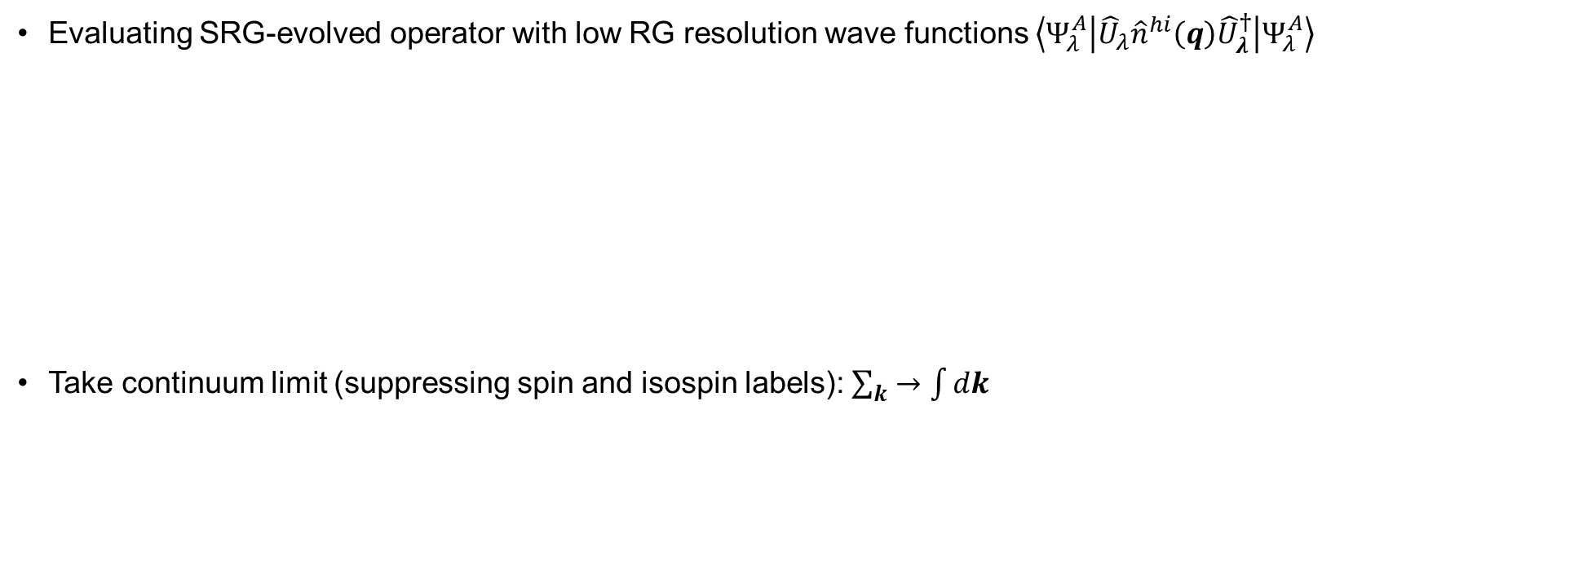
HF and LDA calculation
Evaluating SRG-evolved operator with low RG resolution wave functions $\left\langle Ψ_{λ}^{A} | {\hat{U}}_{λ}{\hat{n}}^{hi}\left(q\right){\hat{U}}_{λ}^{†} | Ψ_{λ}^{A}\right\rangle$
Take continuum limit (suppressing spin and isospin labels): $\sum_{k}{→\int{dk}}$

Slide 37
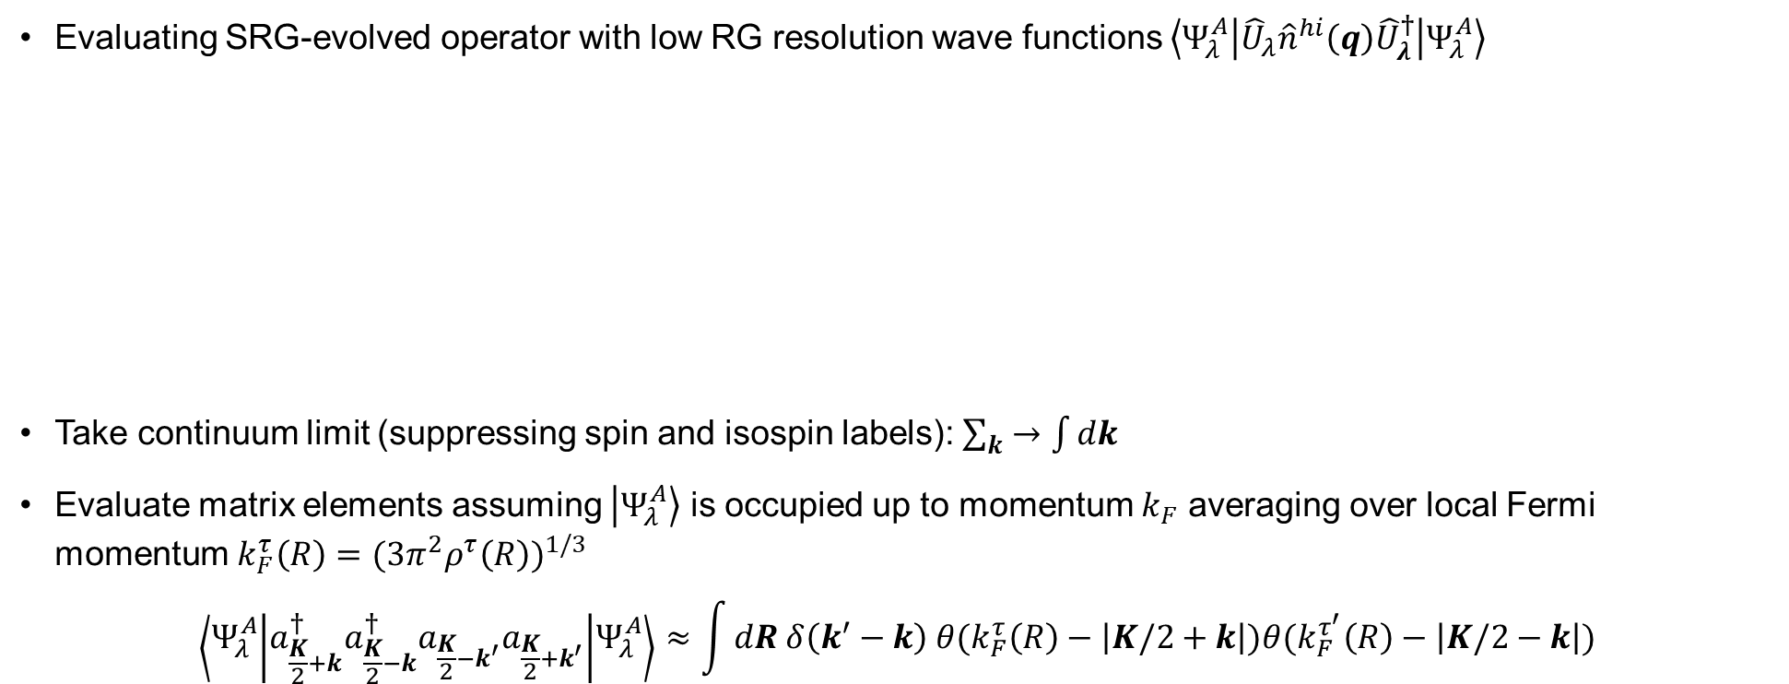
HF and LDA calculation
Evaluating SRG-evolved operator with low RG resolution wave functions $\left\langle Ψ_{λ}^{A} | {\hat{U}}_{λ}{\hat{n}}^{hi}\left(q\right){\hat{U}}_{λ}^{†} | Ψ_{λ}^{A}\right\rangle$
Take continuum limit (suppressing spin and isospin labels): $\sum_{k}{→\int{dk}}$
Evaluate matrix elements assuming $\left|\left.Ψ_{λ}^{A}\right\rangle \right.$ is occupied up to momentum $k_{F}$ averaging over local Fermi momentum $k_{F}^{τ}\left(R\right)={(3π^{2}ρ^{τ}\left(R\right))}^{1/3}$
$$\left\langle Ψ_{λ}^{A} | a_{\frac{K}{2}+k}^{†}a_{\frac{K}{2}−k}^{†}a_{\frac{K}{2}−k^{′}}a_{\frac{K}{2}+k^{′}} | Ψ_{λ}^{A}\right\rangle ≈\int{dR δ\left(k^{′}−k\right) θ(k_{F}^{τ}\left(R\right)−\left|K/2+k\right|)θ(k_{F}^{τ^{′}}\left(R\right)−\left|K/2−k\right|})$$

Slide 38
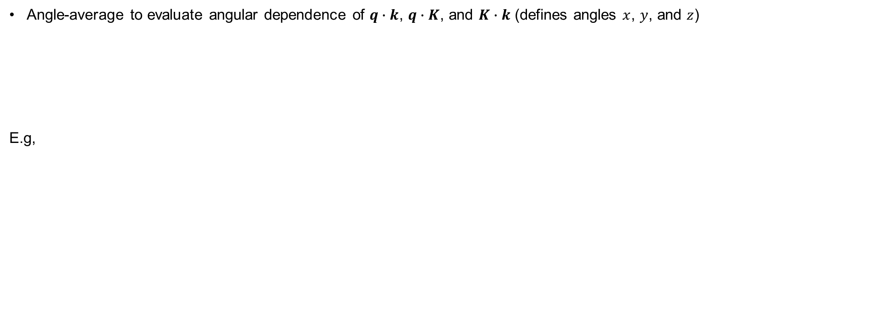
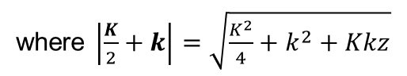
HF and LDA calculation
Angle-average to evaluate angular dependence of $q∙k$, $q∙K$, and $K∙k$ (defines angles $x$, $y$, and $z$)
E.g,
where $\left|\frac{K}{2}+k\right|=\sqrt{\frac{K^{2}}{4}+k^{2}+Kkz}$

Slide 39
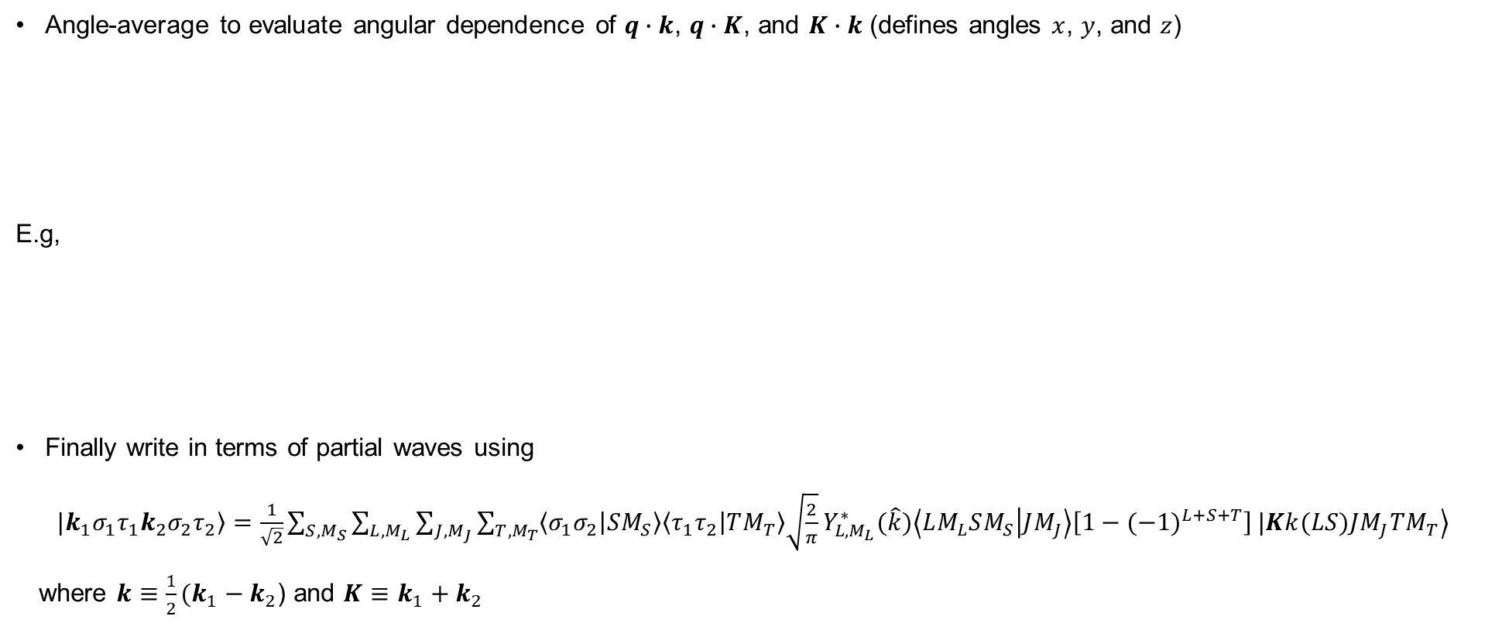
HF and LDA calculation
Angle-average to evaluate angular dependence of $q∙k$, $q∙K$, and $K∙k$ (defines angles $x$, $y$, and $z$)
E.g,
Finally write in terms of partial waves using
$\left.|k_{1}σ_{1}τ_{1}k_{2}σ_{2}τ_{2}\right\rangle$ $=\frac{1}{\sqrt{2}}\sum_{S,M_{S}}{\sum_{L,M_{L}}{\sum_{J,M_{J}}{\sum_{T,M_{T}}{\left\langle σ_{1}σ_{2} | SM_{S}\right\rangle \left\langle τ_{1}τ_{2} | TM_{T}\right\rangle \sqrt{\frac{2}{π}}}Y_{L,M_{L}}^{∗}(\hat{k})\left\langle LM_{L}SM_{S} | JM_{J}\right\rangle \left[1−{(−1)}^{L+S+T}\right]}}}\left.|Kk(LS)JM_{J}TM_{T}\right\rangle$
where $k≡\frac{1}{2}(k_{1}−k_{2}$) and $K≡$ $k_{1}+k_{2}$
where $\left|\frac{K}{2}+k\right|=\sqrt{\frac{K^{2}}{4}+k^{2}+Kkz}$

Slide 40
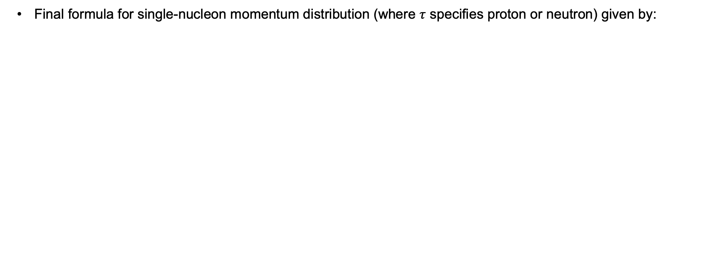
HF and LDA calculation
Final formula for single-nucleon momentum distribution (where $τ$ specifies proton or neutron) given by:

Slide 41
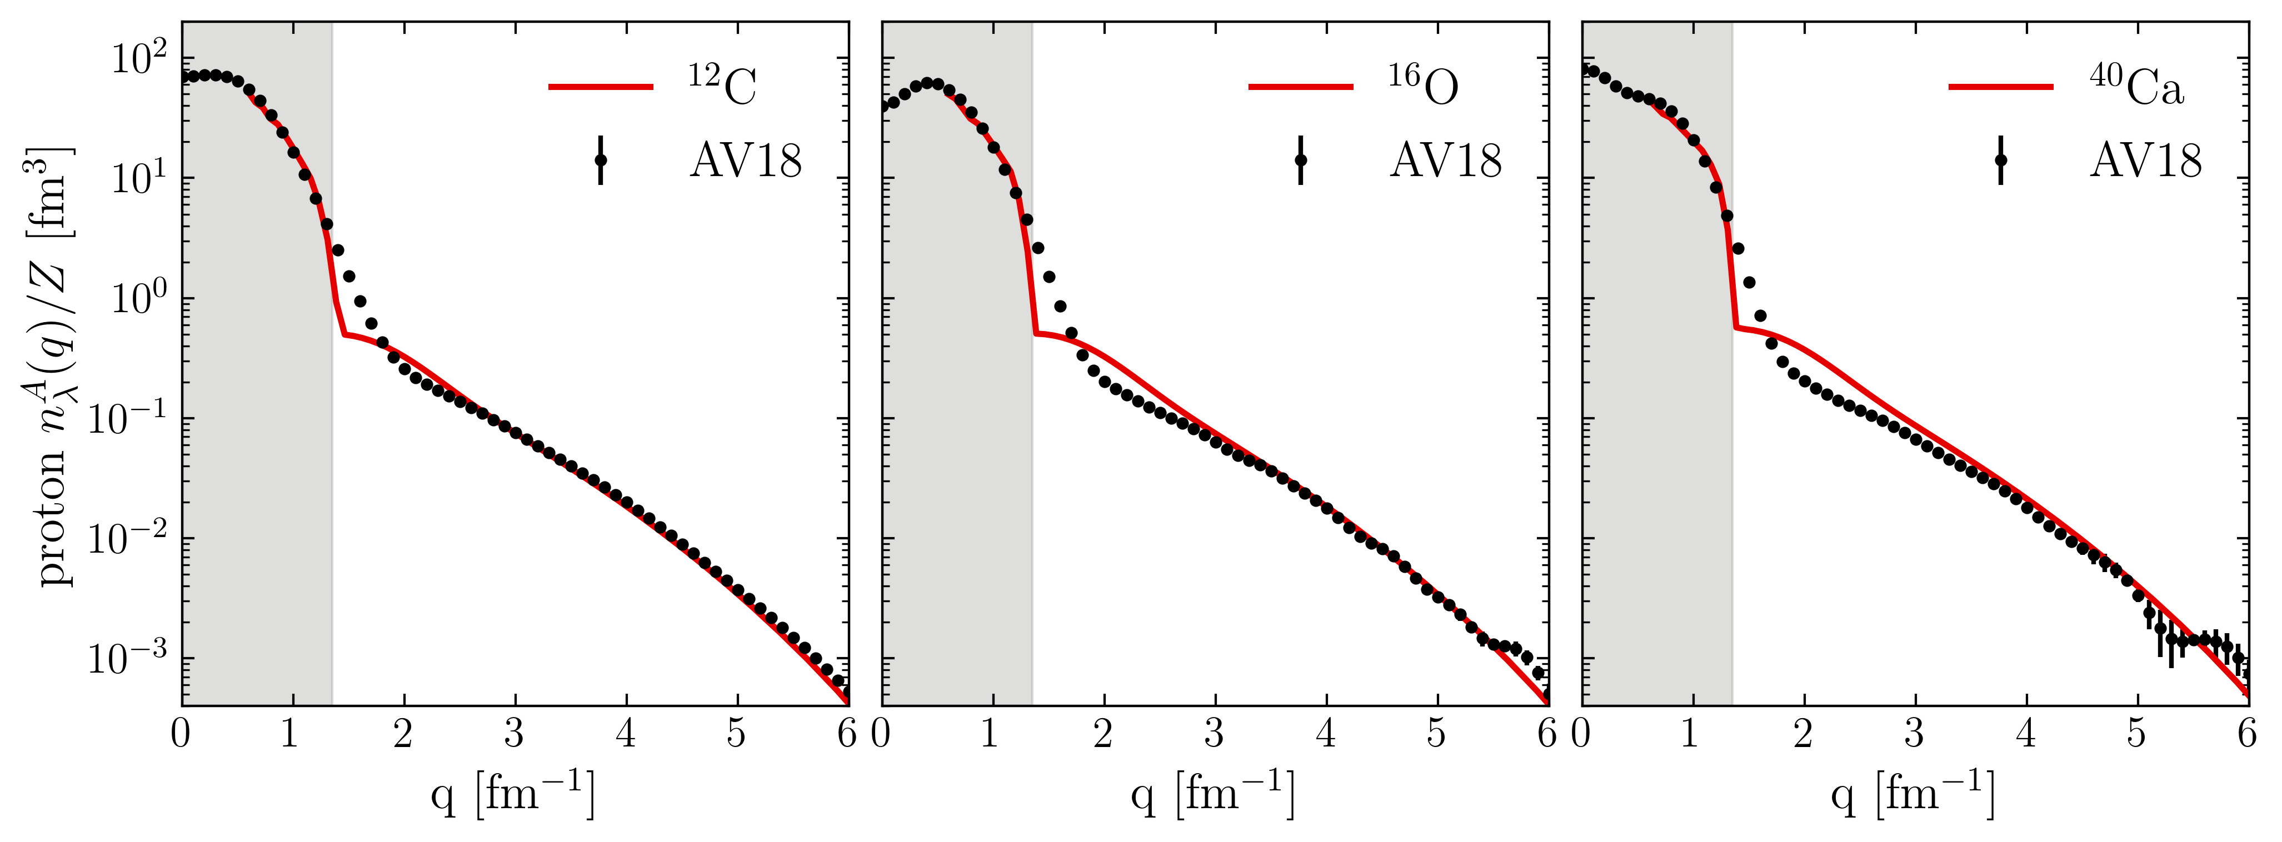
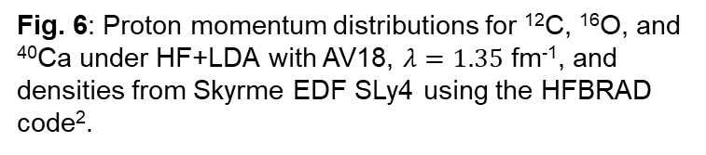
Proton momentum distributions
¹R.B. Wiringa et al., Phys. Rev. C 89, 024305 (2014)
https://www.phy.anl.gov/theory/research/momenta/
²K. Bennaceur et al., Comput. Phys. Commun. 168, 96 (2005)
Low RG resolution calculations reproduce momentum distributions of AV18 QMC calculations¹ (high RG resolution)
Fig. 6: Proton momentum distributions for ¹²C, ¹⁶O, and ⁴⁰Ca under HF+LDA with AV18, $λ=1.35$ fm⁻¹, and densities from Skyrme EDF SLy4 using the HFBRAD code².
Notes:
Compare to AV18 QMC calculations
“We can get a good description of proton momentum distributions using densities from just a Skyrme EDF (SLy4) and 2-body physics shifted into the operator”, emphasize that the high-q tail works well.
Why is the intermediate q region the worst? Operator cut at 2-body and WF is just HF. (IMSRG decoupling example).
Why isn’t low-q showing? Low-q corresponds to large-r in LDA where a local density approximation will not work.

Slide 42
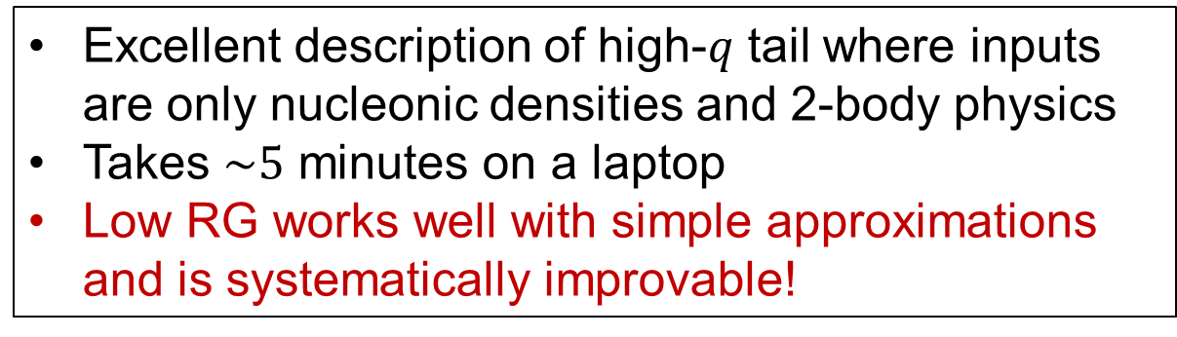
Proton momentum distributions
¹R.B. Wiringa et al., Phys. Rev. C 89, 024305 (2014)
https://www.phy.anl.gov/theory/research/momenta/
²K. Bennaceur et al., Comput. Phys. Commun. 168, 96 (2005)
Low RG resolution calculations reproduce momentum distributions of AV18 QMC calculations¹ (high RG resolution)
Excellent description of high-$q$ tail where inputs are only nucleonic densities and 2-body physics
Takes $\sim 5$ minutes on a laptop
Low RG works well with simple approximations and is systematically improvable!
Fig. 6: Proton momentum distributions for ¹²C, ¹⁶O, and ⁴⁰Ca under HF+LDA with AV18, $λ=1.35$ fm⁻¹, and densities from Skyrme EDF SLy4 using the HFBRAD code².
Notes:
Compare to AV18 QMC calculations
“We can get a good description of proton momentum distributions using densities from just a Skyrme EDF (SLy4) and 2-body physics shifted into the operator”, emphasize that the high-q tail works well.
Why is the intermediate q region the worst? Operator cut at 2-body and WF is just HF. (IMSRG decoupling example).
Why isn’t low-q showing? Low-q corresponds to large-r in LDA where a local density approximation will not work.

Slide 43
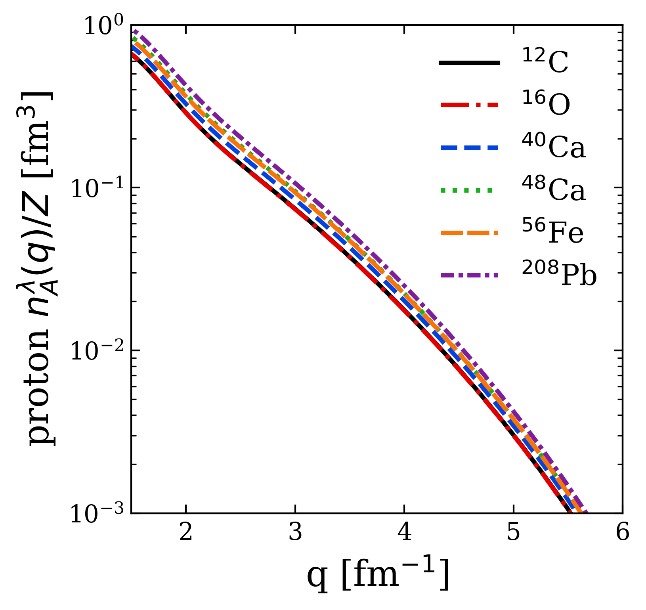


Proton momentum distributions
Universality: High-$q$ dependence from universal function $≈{\left|F_{λ}^{hi}\left(q\right)\right|}^{2}$ fixed by 2-body and insensitive to nucleus
Fig. 7: Proton momentum distributions under HF+LDA with AV18 and $λ=1.35$ fm⁻¹, showing several nuclei.
Notes:
High momentum dependence is fixed by 2-body and does not depend on the nucleus.

Slide 44



Proton momentum distributions
Consistent with universal high-$q$ tails from QMC calculations of R. B. Wiringa et al., Phys. Rev. C 89, 024305 (2014)
Fig. 7: Proton momentum distributions under HF+LDA with AV18 and $λ=1.35$ fm⁻¹, showing several nuclei.
Notes:
Universality consistent with AV18 QMC calculations as well which is seen here by comparing the high momentum tails of the various momentum distributions.

Slide 45


SRC scaling factors
SRC scaling factors $a_{2}$ defined by plateau in cross section ratio $\frac{2σ_{A}}{Aσ_{d}}$ at $1.45≤x≤1.9$
Closely related to the ratio of bound-nucleon probability distributions in the limits of vanishing relative distance (infinitely high relative momentum)
Extract $a_{2}$ from momentum distributions
$$a_{2}=\lim_{q→∞}{\frac{P^{A}(q)}{P^{d}(q)}≈}\frac{\int_{Δq^{high}}{dqP^{A}(q)}}{\int_{Δq^{high}}{dqP^{d}(q)}}$$
where $P^{A}\left(q\right)$ is the single-nucleon probability distribution in nucleus A
$$a_{2}$$
Fig. 8: Ratio of per-nucleon electron scattering cross section of nucleus A to that of deuterium, where the red line indicates a constant fit. Figure from B. Schmookler et al. (CLAS), Nature 566, 354 (2019).
Notes:
SRC scaling factors determined by constant plateau in cross section ratios of A/d indicated by this red line for several nuclei.
Second bullet.
Probability distribution is proportional to the momentum distribution.
We can produce SRC scale factors using momentum distributions at high momentum.

Slide 46



SRC scaling factors
¹E. Chabanat et al., Nucl. Phys. A 635, 231 (1998)
²J. Decharge et al., Phys. Rev. C 21, 1568 (1980)
³B. Schmookler et al. (CLAS), Nature 566, 354 (2019)
⁴J. Ryckebusch et al., Phys. Rev. C 100, 054620 (2019)
$$a_{2}=\lim_{q→∞}{\frac{P^{A}(q)}{P^{d}(q)}≈}\frac{\int_{Δq^{high}}{dqP^{A}(q)}}{\int_{Δq^{high}}{dqP^{d}(q)}}$$
High momentum behavior is characterized by 2-body ${\left|F_{λ}^{hi}\left(q\right)\right|}^{2}$ which cancels leaving ratio of mean-field (low-$k$) physics
Good agreement with $a_{2}$ values from experiment³ and LCA calculations⁴ using two different EDFs
Error bars from varying $Δq^{high}$
Fig. 9: $a_{2}$ scale factors using single-nucleon momentum distributions under HF+LDA (SLy4 in red¹, Gogny² in blue) with AV18 and $λ=1.35$ fm⁻¹ compared to experimental values³.
Notes:
Gives good agreement with experiment and LCA calculations from this reference (point) using two different EDFs.
a2 is extracted from inclusive cross section ratios of \sigma^A / \sigma^d which plateau at high Bjorken x.

Slide 47
SRC phenomenology
np includes ¹S₀ and ³S₁-³D₁
Scalar limit
At high RG resolution, the tensor force and the repulsive core of the NN interaction kicks nucleon pairs into SRCs
np dominates because the tensor force requires spin triplet pairs, whereas pp are spin singlets
Do we describe this physics at low RG resolution?
Fig. 10: (a) Ratio of two-nucleon to single-nucleon electron-scattering cross sections for carbon as a function of missing momentum. (b) Fraction of np to p and pp to p pairs versus the relative momentum. Figure from CLAS collaboration publication¹.
¹I. Korover et al. (CLAS), arXiv:2004.07304 (2014)
Notes:
Don't bother describing (a) - just say these are cross section ratios on the left, on the right are the pair fraction of proton-neutron and proton-proton.
The takeaway is at high RG resolution, the tensor force… (fast!)

Slide 48



SRC phenomenology
np dominance
At low RG resolution, SRCs are suppressed in the wave function and shifted into the operator
$${\hat{n}}^{lo}\left(q\right)={\hat{U}}_{λ}a_{q}^{†}a_{q}{\hat{U}}_{λ}^{†}=U_{λ}(k,q)U_{λ}^{†}(q,k^{′})$$
Take ratio of ³S₁ and ¹S₀ SRG transformations fixing low-momenta to $k_{0}=0.1$ fm⁻¹
This physics is established in the 2-body system – can apply to any nucleus!
Scalar limit
Fig. 11: ³S₁ to ¹S₀ ratio of SRG-evolved momentum projection operators $a_{q}^{†}a_{q}$ where $λ=1.35$ fm⁻¹.

Slide 49


SRC phenomenology
Low RG resolution picture reproduces the characteristics of cross section ratios using simple approximations
np dominance
Scalar limit
Fig. 12: pp/pn ratio of pair momentum distributions under HF+LDA with AV18 and $λ=1.35$ fm⁻¹.

Slide 50

SRC phenomenology
Low RG resolution picture reproduces the characteristics of cross section ratios using simple approximations
Weak nucleus dependence from factorization
Ratio$≈\frac{{\left|F_{pp}^{hi}(q)\right|}^{2}}{{\left|F_{np}^{hi}(q)\right|}^{2}}×\frac{\left\langle Ψ_{λ}^{A} | \sum_{k,k′}^{λ}{a_{\frac{Q}{2}+k}^{†}a_{\frac{Q}{2}−k}^{†}a_{\frac{Q}{2}−k^{′}}a_{\frac{Q}{2}+k^{′}}} | Ψ_{λ}^{A}\right\rangle }{\left\langle Ψ_{λ}^{A} | \sum_{k,k′}^{λ}{a_{\frac{Q}{2}+k}^{†}a_{\frac{Q}{2}−k}^{†}a_{\frac{Q}{2}−k^{′}}a_{\frac{Q}{2}+k^{′}}} | Ψ_{λ}^{A}\right\rangle }$
np dominance
Scalar limit
Fig. 12: pp/pn ratio of pair momentum distributions under HF+LDA with AV18 and $λ=1.35$ fm⁻¹.

Slide 51



SRC phenomenology
Ratio $\sim 1$ independent of N/Z in np dominant region
Ratio $<1$ for nuclei where N $>$ Z and outside np dominant region
np dominance
Fig. 13: (pp+pn)/(nn+np) ratio of pair momentum distributions under HF+LDA with AV18 and $λ=1.35$ fm⁻¹.
Notes:
We can also look at isospin dependence: by taking ratios we see the pn-dominant region is independent of N/Z while the scalar limits depends on N/Z.

Slide 52


Other exclusive knockout reactions
Apply similar low RG analysis to exclusive knockout reactions in ($e$,$e^{′}p$) scattering
Nucleon knocked out from specific shell model state of target nucleus $A$
In progress
Fig. 14: Momentum profiles as function of missing momentum for valence holes in nuclei. Data (black points) from NIKHEF experiments. Figure from T. Aumann et al., Prog. Part. Nucl. Phys. 118, 103847 (2021).
Notes:
Next we consider applying the same sort of analysis but for exclusive knockout reactions in (e,e’p) scattering.
In this reaction, a nucleon is knocked out from a specific state of the target nucleus.
Mention much lower momentum scale than what was considered prior.

Slide 53

Other exclusive knockout reactions
Apply similar low RG analysis to exclusive knockout reactions in ($e$,$e^{′}p$) scattering
Nucleon knocked out from specific shell model state of target nucleus $A$
Momentum dependence of ($e$,$e^{′}p$) exclusive cross section is dominated by the single-particle (sp) wave function
Spectroscopic factor needed to reduce the theoretical cross section to match experiment
In progress
Fig. 14: Momentum profiles as function of missing momentum for valence holes in nuclei. Data (black points) from NIKHEF experiments. Figure from T. Aumann et al., Prog. Part. Nucl. Phys. 118, 103847 (2021).
Notes:
Here is a figure showing the reduced cross section for several nuclei comparing to data from NIKHEF experiments.
The momentum dependence is well described by the sp momentum distribution but a spectroscopic factor is necessary to agree with experiment.

Slide 54


Other exclusive knockout reactions
Systematic trend for discrepancy in exp/theory as a function of $ΔS$
RG analysis can help understand the cause of $R=\frac{σ_{exp}}{σ_{theory}}<1$
Mismatch of scale between one-body (high RG) operator and shell model structure (low RG) gives $σ_{theory}>σ_{exp}$
Fig. 15: $R$ as a function of $∆S$. Red (blue) points correspond to neutron-removal (proton-removal) cases. Solid black squares correspond to electron-induced proton knockout data. Figure from J. A. Tostevin and A. Gade, Phys. Rev. C 90, 057602 (2014).
Notes:
Furthermore, the factor difference between theory and experiment varies with \Delta S, the difference in nucleon separation energy, shown here in this plot.
Explain picture: This plot shows the ratio of experimental over theory cross sections as a function of \Delta S for various knock-out reactions: black, red, blue.
We see the ratio decreases as \Delta S increases.
The origin of this is not understood but could be stemming from the (second bullet).

Slide 55


Other exclusive knockout reactions
Systematic trend for discrepancy in exp/theory as a function of $ΔS$
RG analysis can help understand the cause of $R=\frac{σ_{exp}}{σ_{theory}}<1$
Mismatch of scale between one-body (high RG) operator and shell model structure (low RG) gives $σ_{theory}>σ_{exp}$
Currently working on SRG-evolving spectroscopic factors for $(e,e^{′}p)$ reactions
Note, spectroscopic factors are scale/scheme dependent
In progress
Fig. 15: $R$ as a function of $∆S$. Red (blue) points correspond to neutron-removal (proton-removal) cases. Solid black squares correspond to electron-induced proton knockout data. Figure from J. A. Tostevin and A. Gade, Phys. Rev. C 90, 057602 (2014).
Notes:
To better understand this, we are currently working on SRG-evolving spectroscopic factors for (e,e’p) reactions.
Note, SFs are scale/scheme dependent so using the RG is the correct way for analyzing them.

Slide 56


Spectroscopic factors
Spectroscopic factor for sp state $α$ defined in terms of removal amplitude
$$S=\int{dp{\left|\left\langle Ψ_{α}^{A−1} | a_{p} | Ψ_{0}^{A}\right\rangle \right|}^{2}}$$

Slide 57


Spectroscopic factors
Spectroscopic factor for sp state $α$ defined in terms of removal amplitude
$$S=\int{dp{\left|\left\langle Ψ_{α}^{A−1} | a_{p} | Ψ_{0}^{A}\right\rangle \right|}^{2}}$$
sp strength is reduced relative to the independent-particle model (IPM) by correlations: Long-range correlations (LRC) and SRC

Slide 58
Spectroscopic factors
Spectroscopic factor for sp state $α$ defined in terms of removal amplitude
$$S=\int{dp{\left|\left\langle Ψ_{α}^{A−1} | a_{p} | Ψ_{0}^{A}\right\rangle \right|}^{2}}$$
sp strength is reduced relative to the independent-particle model (IPM) by correlations: Long-range correlations (LRC) and SRC
Idea: SRG evolve and analyze using simple approximations (i.e., IPM)

Slide 59
Summary and outlook
At low renormalization group (RG) resolution, simple approximations to SRC physics work and are systematically improvable
Results suggest that we can analyze high-energy nuclear reactions using low RG resolution structure (e.g., shell model) and consistently evolved operators
Matching resolution scale between structure and reactions is crucial!

Slide 60

Summary and outlook
At low renormalization group (RG) resolution, simple approximations to SRC physics work and are systematically improvable
Results suggest that we can analyze high-energy nuclear reactions using low RG resolution structure (e.g., shell model) and consistently evolved operators
Matching resolution scale between structure and reactions is crucial!
Ongoing work:
Extend to $(e,e^{′}p)$ knockout cross sections and test scale/scheme dependence of extracted properties
Investigate impact of various corrections: 3-body terms, final state interactions, etc.
Apply to more complicated knock-out reactions (SRG with optical potentials)
Implement uncertainty quantification in low RG resolution calculations

Slide 61
Extras
Fig. 16: Cartoon snapshots of a nucleus at (left) low-RG and (right) high-RG resolutions. The back-to-back nucleons at high-RG resolution are an SRC pair with small center-of-mass momentum.

Slide 62
Extras
Kinematics chosen such that two-nucleon knock-out dominates
Break up the pair, detect both nucleons, and reconstruct initial state
Kinematics minimize final state interactions and meson exchange currents

Slide 63

Extras
Universality: Low-energy physics of different interactions becomes the same at low RG resolution
Fig. 17: Initial and SRG-evolved deuteron wave functions in coordinate space for several chiral interactions.
Fig. 18: SRG evolution for several chiral interactions in the ³S₁-³S₁ channel.

Slide 64


Extras
Consider an operator dominated by high momentum $q$ where $k<λ$ and $q≫λ$
Expand the eigenstates $ψ_{α}^{∞}$ of the initial NN Hamiltonian in terms of the SRG-evolved states $ψ_{α}^{λ}$
$$ψ_{α}^{∞}\left(q\right)≈γ^{λ}\left(q\right)\int_{0}^{λ}{d\tilde{p}Z\left(λ\right)ψ_{α}^{λ}\left(p\right)+η^{λ}\left(q\right)\int_{0}^{λ}{d\tilde{p}p^{2}Z\left(λ\right)ψ_{α}^{λ}\left(p\right)}}+⋯$$
Substitute leading-order term of operator product expansion (OPE) in spectral representation of SRG transformation
$$U_{λ}\left(k,q\right)=\sum_{α}^{∞}{\left\langle k | ψ_{α}^{λ}\right\rangle \left\langle ψ_{α}^{∞} | q\right\rangle }$$
$$≈[\sum_{α}^{\left|E_{α}\right|≪\left|E_{QHQ}\right|}{\left\langle k | ψ_{α}^{λ}\right\rangle }\int_{0}^{λ}{d\tilde{p}Z\left(λ\right)ψ_{α}^{λ†}\left(p\right)]}γ^{λ}\left(q\right)$$
$$≡K_{λ}(k)Q_{λ}(q)$$
Fig. 19: Ratio of $δUδU^{†}(k,q)$ for fixed $k$ and $λ$.
Notes:
Short-distance details decouple from long-distance dynamics.
Initial operator is dominated by high momenta.
Focus on k<\lambda and q>>\lambda.
\psi_\alpha^\infinity(q) \approx \gamma^\lambda(q) \int_0^\lambda dp^\tilde Z(\lambda) \psi_\alpha^\lambda(p) + … (analog of Lepage’s operator product expansion)

